Slide 1
Title Slide
Spider Feasibility: a structured approach to quality improvement
Michelle Greiver, Simone Dahrouge, Patricia O’Brien, Donna Manca, Alex Singer, Marie-Therese Lussier, Celine Jean-Xavier

Slide 2
COI – Presenter Disclosure (1)
Presenter Disclosure
Presenter: Michelle Greiver
Relationships with financial sponsors:
Any direct financial relationships, including receipt of honoraria: Grant to my Department from Sanofi, GSK and Novartis for development of a severe asthma registry using EMR data (unrelated to this project)
Membership on advisory boards or speakers’ bureaus: None
Patents for drugs or devices: None
Other: None
Notes:
Where a faculty/presenter has no relationships to disclose, indicate Not Applicable under Relationships with Financial Sponsors.
Complete this slide for the primary presenter and ALL co-presenters if applicable.
Reminder: Disclosures made on your COI forms should match disclosures made on the COI slide.

Slide 3
COI – Presenter Disclosure (2)
Disclosure of Financial Support
This program has received financial support from CIHR in the form of a Research Grant for SPIDER
This program has received in-kind support from UofT DFCM and North York General Hospital in the form of logistical support
Potential for conflict(s) of interest: Dr Greiver has receives payment from the UofT DFCM as a Research Program Advisor
Notes:
Where a program has received no external financial support (e.g., monies for food, logistics assistance such as registration, AV set-up, etc.), indicate No External Support.

Slide 4
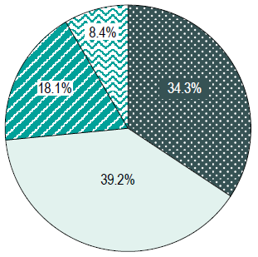
Background
Polypharmacy amongst seniors is prevalent, and may harm patients
1 out of 4 Canadian seniors (26.5%) fill prescriptions for 10⁺ different meds each year¹
# of meds prescribed to a patient is the single most reliable index of persistent complexity after age²
10⁺ meds prescribed for seniors is strongly associated with high care needs for 3 consecutive years: specificity = 95.3%²
Percentage of older patients by # of medication classes
Odds of ongoing high healthcare costs
# of meds
1. Canadian Institute for Health Information. Drug Use Among Seniors in Canada, 2016. Ottawa, ON: CIHI; 2018.
2. Dahrouge S, Wodchis W. Identifying high users in Ontario - an algorithm for use in primary care practices. in preparation

Slide 5
Background
What to improve?
Medication Appropriateness:
↓ use of potentially inappropriate meds
PPIs
benzos/Z-drugs
antipsychotics
sulfonylureas
How could we improve?
SPIDER*: evidence-based QI initiatives
How to measure the impact?
Quintuple Aim
*SPIDER: Structured Process Informed by Data, Evidence and Research

Slide 6
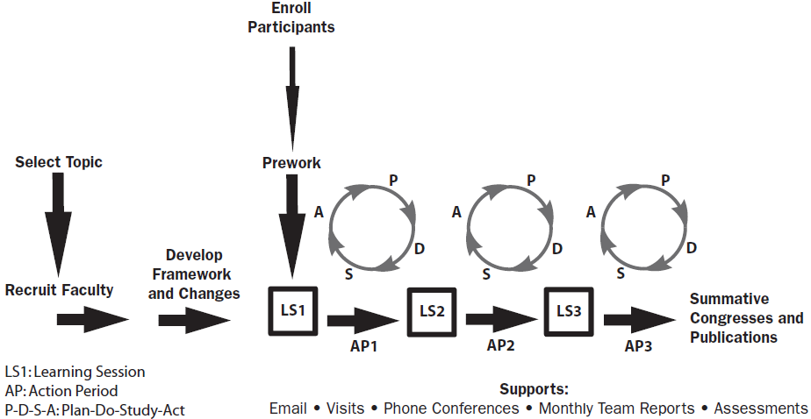
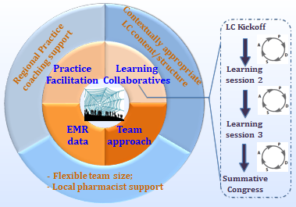
The SPIDER approach
Based on IHI’s Breakthrough Series Model
Core elements: Learning Collaboratives, coaching, EMR data for audit & feedback
Feasibility study (3 PBRNs) → clustered pragmatic RCTs (7 PBRNs)
Notes:
A complex study. Feasibility study with 3 PBLRNs, which is the focus for today’s presentation

Slide 7
Measures for feasibility
Feasibility across 7 dimensions
Demand
Implementation
Adaptation
Integration
Practicality
Acceptability
Efficacy
Notes:
Feasibility also looked at ability to measure

Slide 8
Demand
Sites
PBRNs | # approached | #declined/no response | # enrolled | # withdrawn | Total | Target | # enrolled /# approached
UTOPIAN (Toronto) | 15 | 5 | 10 | 0 | 10 | 8 | 67%
NAPCReN (Edmonton) | 8 | 4 | 4 | 1 | 3 | 8 | 50%
RRSPUM (Montreal) | 4 | 0 | 4 | 0 | 4 | 8 | 100%
Total | 27 | 9 | 18 | 1 | 17 | 24 | 67%
 | Toronto | Edmonton | Montreal | Total
FPs | 33 | 8 | 21 | 62
NPs | 3 |  | 5 | 8
Nurses | 4 | 1 |  | 5
Pharmacists | 8 |  | 4 | 12
PAs | 1 |  |  | 1
QI agent | 2 | 3 | 2 | 7
Residents | 4 | 6 |  | 10
Admin | 2 | 1 | 2 | 5
Patients partners |  |  | 5 | 5
Total participants | 57 | 19 | 39 | 115
Notes:
70% of target enrolled

Slide 9
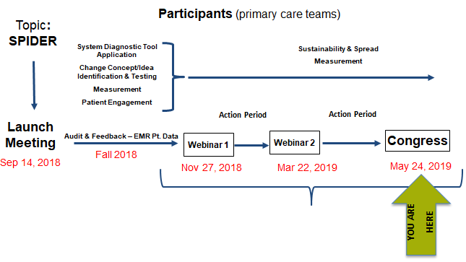
Implementation
Toronto Learning Collaborative
Outcome measure | Data Source | Method and timing of data collection
Ability to apply the SPIDER elements as planned | Coordinator’s log | Maintained by RC and QI coach
Implementation facilitators and barriers; best practices | Coordinator’s log/ QI coach log
Audit and feedback | Yes
Coaching notes | In some settings (Toronto)
Learning Collaborative | In some settings (Toronto); Scheduling was difficult

Slide 10
Adaptation, integration, practicality
Outcome measure | Data Source | Method and timing of data collection
Ability to integrate the process into existing practice | Semi-structured interview with selected practices | Interview, post LC
Change strategies varied
Dependent on local context (capacity, resources and previous experience in QI)
Solutions focused on
Cleaning medication data in EMR
Adding functionalities in EMR: e.g., CPP band, side panel, flag SPIDER patients
Improving documentation of discussion and shared decision-making: e.g., customized deprescribing form
Enhancing routine medication reconciliation: e.g., appointments specifically for med reconciliation/deprescription
Access to a Pharmacist was a key enabler
Translating/adapting the workshop materials to French and setting up a collaboration de the COMPAS QI group from INESSS was a major enabler for RRSPUM

Slide 11
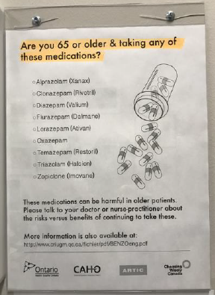
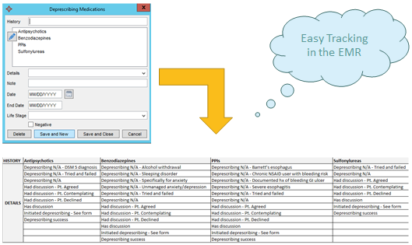
What participants did
Notes:
Michelle

Slide 12
Acceptability
High level of engagement
High willingness to share and high degree of collaboration
Teams’ work documents were shared between sites
Under-resourced teams received external pharmacist support: e.g., the solo practice and the CHC
Higher than anticipated access to coaching support
The majority had a monthly hour-long meeting with the coach
Engagement of FM residents
Notes:
Survey, focus groups

Slide 13
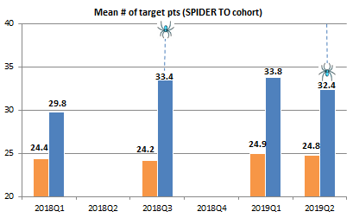
Efficacy
Toronto
Average # of pts/physician: 24 (range 6-116)
Number of PIPs/patient: 1 (SD .8)
Efficacy
* PIP prevalence = $\frac{\# of PIP in target population}{\# of patients in target population}$
Absolute reduction in PIP prevalence per patient* | 3.6% (p = n. s.)
Absolute reduction in % of patients with at least 1 PIP | 1.4% (p = n. s.)
Network | Baseline surveys completed | PCP enrolled | percentage
Edmonton | 15 | 20 | 75%
Toronto | 25 | 58 | 43%
Total | 40 | 78 | 51%
Patient participants | Post intervention survey on their experience of deprescribing
PBRNs | # approached | #declined/no response | # enrolled
UTOPIAN | 70 | 67 | 3
NAPCReN | 0 | 0 | 0
RRSPUM | 0 | 0 | 0
Total | 70 | 67 | 3

Slide 14
Conclusions
Feedback and coaching can be implemented in practice
Learning Collaboratives may present scheduling challenges
Team resources were needed to support the intervention
Access to coaching support and pharmacist services were important
SPIDER was feasible, with a trend towards improved outcomes
Pandemic required shift to Virtual Learning Collaboratives during RCT
We used what we learned for the RCT

Slide 15
Closing Slide
Thank you!
Please fill out your session evaluation now!
#myfmf
michelle.greiver@nygh.on.ca
https://www.spiderdeprescribing.com/
FamilyMedicineForum
FamilyMedForum
FamilyMedForum

