Slide 1

Curriculum Mapping
Practical Strategies

Slide 2

Land acknowledgement
The University of Manitoba campuses and research spaces are located on original lands of Anishinaabeg, Ininiwak, Anisininewuk, Dakota Oyate, Dene Inuit, and on the National Homeland of the Red River Métis.
UM recognizes that the Treaties signed on these lands are a lifelong, enduring relationship, and we are dedicated to upholding their spirit and intent. We acknowledge the harms and mistakes of the past and the present. With this understanding, we commit to supporting Indigenous excellence through active Reconciliation, meaningful change, and the creation of an environment where everyone can thrive. Our collaboration with Indigenous communities is grounded in respect and reciprocity and this guides how we move forward as an institution.

Slide 3

No conflicts of interest to declare
This Photo by Unknown author is licensed under CC BY-SA.

Slide 4

Joanne Hamilton, RD, MEd, EdD
Office of Innovation and Scholarship in Medical Education
Max Rady College of Medicine
This Photo by Unknown Author is licensed under CC BY-NC

Slide 5
Objectives
Describe the purposes and principles of curriculum mapping
Prepare a curriculum map

Slide 6
Outline
What is a curriculum?
What are the purposes of a curriculum map
What are the principles outlined by CanERA for a curriculum map
How to map your curriculum

Slide 7
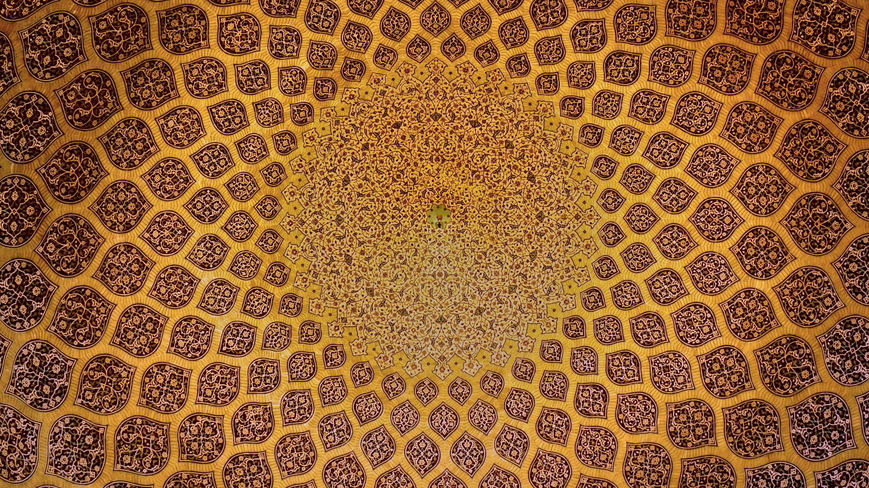
What is a Curriculum?
Notes:
Get the group to define what a curriculum is- what’s included..

Slide 8
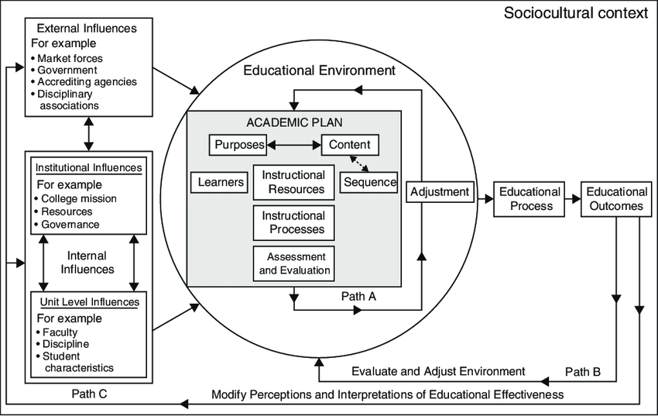
What is curriculum?
An Academic Plan!
-
(Lattuca and Stark, 2011)
Notes:
Purposes - the knowledge, skills, and attitudes to be learned)
Content (subject matter selected to convey specific knowledge, skills, and attitudes)
Sequence: arrangement of subject matter and experiences intended to lead to specific outcomes for learners
Learners: how the plan will address a specific group of learners
Instructional processes: instructional activities by which learning may be achieved
Instructional resources: the materials and settings to be used in the learning process
Evaluation: the strategies used to determine whether decisions about the elements of the academic plan are optimal
Adjustment: enhancements to the plan based on experience and evaluation

Slide 9
Underlying curricular assumptions
Educational programs have goals or purposes, whether articulated or not!
Educators have professional and ethical obligations to meet the needs of their learners, patients, and society
Educators should be held accountable for the outcomes of their interventions
American Academy of Family Physicians

Slide 10

What are the purposes of a curriculum map?
Make your curriculum transparent to teachers and learners
Demonstrate links between:
  Content (competencies, milestones, required/recommended training experiences, EPAs)
  Assessment
  Sites/Resources
  Teaching strategies
Demonstrate achievement of learning outcomes
  To accreditors, stakeholders
  With a roadmap to how they’re achieved in a scaffolded way
Helps identify gaps
Helps identify resource needs

Slide 11

CanERA Map ‘Principles’
Map should be available to learners
  To help them make sense of their training
Map should identify
  What is taught
  How it’s taught
  How it’s assessed
Should demonstrate learner progression
  For extra points – include pathway to competence document
Should be comprehensive
  Clinical and academic curriculum

Slide 12

Where to Start?
Decide on organizing framework
Phases of training/PG year
CanMEDS roles/objectives
Collect information
Content (what’s taught)
Context (where it’s taught)
Delivery (how it’s taught)
Assessment
Start mapping
Assess and optimize
Is there progression
Are links clear?
This Photo by Unknown Author is licensed under CC BY-SA

Slide 13

1. Decide on framework

Slide 14
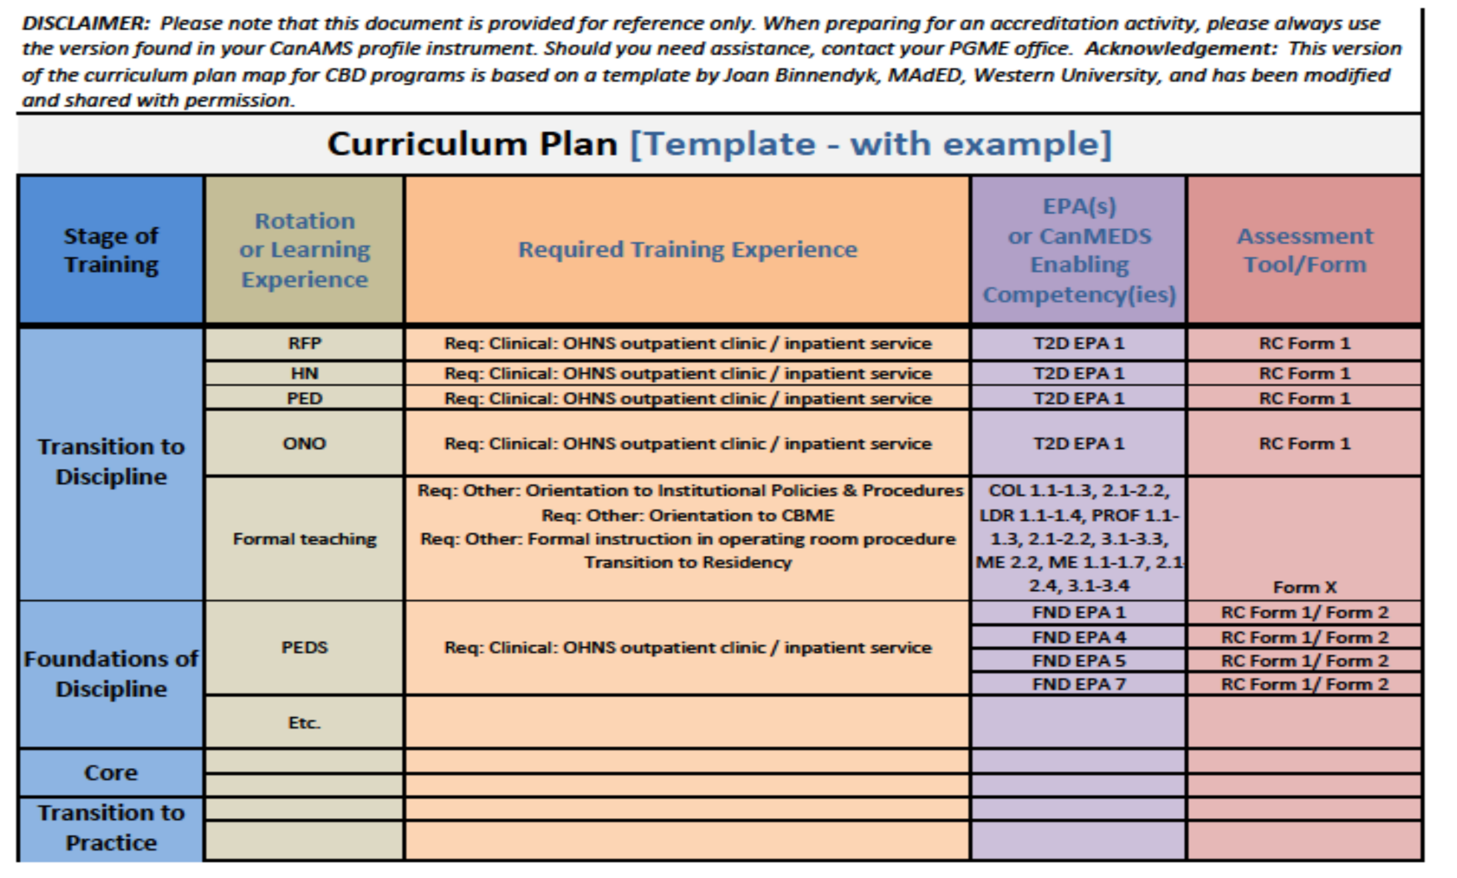

Slide 15
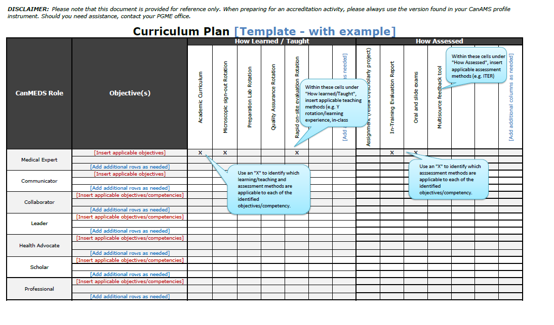

Slide 16
Gather your resources
‘Curricular Content’
Rotation specific objectives
CBD curricular documents
Academic half day topics and/or goals and objectives
Projects (research, QI, Audit etc)
Presentations required
External course goals/objectives
Assessment tools
Clinical Assessments: EPA Assessment instruments/ITARs
Exams
Research, QI or other project
Presentation evaluation tools
Rotation schedule/requirements

Slide 17

Link to CanMEDS Enabling objectives
Rotation objectives should already be organized around CanMEDS ( competencies or Pathways to competence document)
EPAs already map (listed as milestones!)
For others
  What CanMEDS objective does the activity achieve
  E.g. – a CQI Clinical Practice audit project (IM)
    Medical expert, 5.1 and 5.2
    Leader, 1.1, 1.3, 1.4, 4.3,
    ?Health advocate, 2.2 (re: prevention, promotion, and health surveillance??)
    Scholar 1.1, 1.2, 1.3 (practice improvement through learning)
    Professional 2.2

Slide 18
Example
Stage of training | Required Learning Experience (from RC) | Rotation or other experience | CanMEds Role/enabling competency | Assessment method
Core of Discipline | Performance of a practice audit (recommended) | Protected time during IM rotation Presentation during rounds | ME, 5.1 and 5.2 L 1.1, 4.3, S 1.1, 1.2, 1.3 Professional 2.2 | Audit assessment rubric Presentation assessment rubric

Slide 19
CanMEDS Role | CanMEDS 2015 competency | How learned |  |  |  | How Assessed
 |  | QI Practice audit Project | Palliative care rotation | Critical Care Rotation | Academic Half day | QI rubric | QI Presentation | ITAR | Supervisor Form (EPA form 1 | 360 Assessment
Medical Expert
 | 5.1 | X |  |  |  | X | X
 | 5.2 | X |  |  |  | X | X
Communicator
Collaborator
Leader | 1.1 | X |  | X | X (CQI) | X | X | X
 | 1.3 |  |  | X |  | X | X | X
 | 1.4 |  |  |  | X (IFM) | X | X
Health advocate
Scholar | 1.2 | X |  |  | X (CQI) |  | X
Professional

Slide 20

Assess and Optimize
Get feedback
  Anything missing?
  Anything unclear
  Any gaps
Present at RPC
  Feedback
  Analysis
    Gaps
    Progression
    Redundancies
Adjust map based on feedback
Adjust curriculum if gaps/redundancies?

Slide 21

Publish your map
Share with your stakeholders
  Residents
  Teaching Faculty
  Competence Committee members
(and ask for feedback)

Slide 22
Curriculum Mapped!
Review and Revise as needed

Slide 23

Questions?
QUESTIONS?

