Slide 1
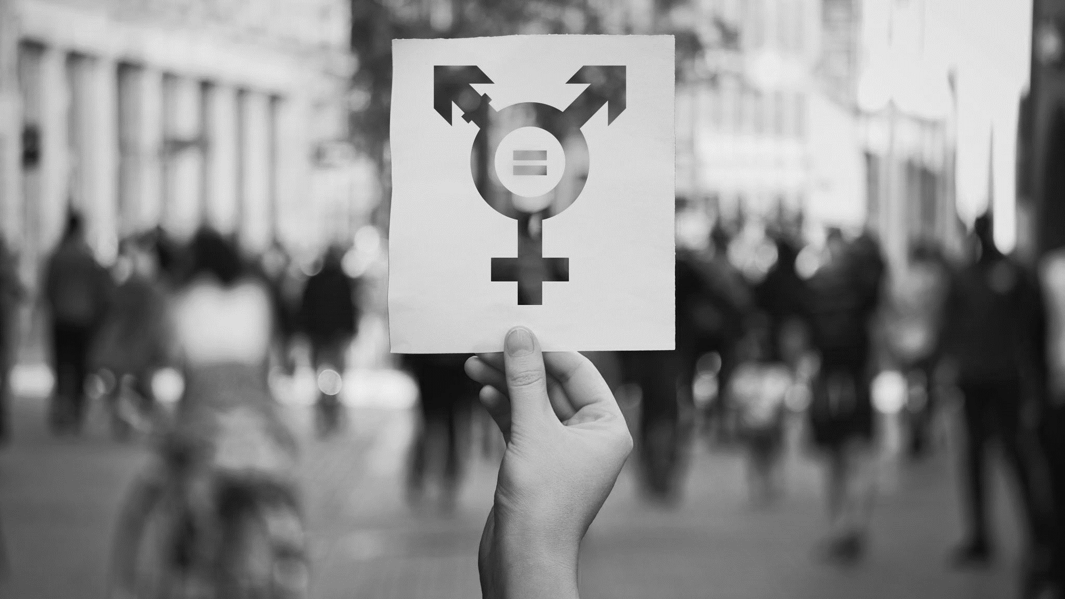
Gender Bias in Health
Affecting patients and providers

Slide 2

Land acknowledgement
The University of Manitoba campuses are located on original lands of Anishinaabeg, Ininiwak, Anisininewuk, Dakota Oyate and Denesuline, and on the National Homeland of the Red River Métis.
We respect the Treaties that were made on these territories, acknowledge the harms of the past and present, and dedicate ourself to move forward in partnership with Indigenous communities in a spirit of Reconciliation and collaboration.
We recognize that this acknowledgment only holds meaning when reflected in the actions taken to address the injustices and barriers that have disproportionally affected Indigenous Peoples and communities, systemically preventing them from accessing and benefitting from education and health care.

Slide 3

Joanne Hamilton, Office of Innovation and Scholarship in Medical Education
Valerie Williams, Office of Equity, Accessibility, and Participation
Max Rady College of Medicine
This Photo by Unknown Author is licensed under CC BY-NC

Slide 4
Objectives
Explain the concepts of gender equity and intersectionality, and assess their impact in (academic) medicine
Evaluate and propose initiatives to address challenges to gender equity (in your learning environment)
Assess the effects of implicit bias in medical education
Discuss the gender pay disparity, and disparity in research funding
Discuss the phenomenon of institutional reproduction
Notes:
Explain the concepts of gender equity and intersectionality, and assess their impact in academic medicine
Evaluate and propose initiatives to address challenges to gender equity in your learning environment
Assess the effects of implicit and unconscious bias in medical education, with particular attention to their impact on evaluation
Discuss the gender pay disparity, and disparity in research funding
Discuss the phenomenon of institutional reproduction

Slide 5

Overview
Activities to get us thinking
Some definitions and examples
Discussion
Wrap up – how does this affect us

Slide 6
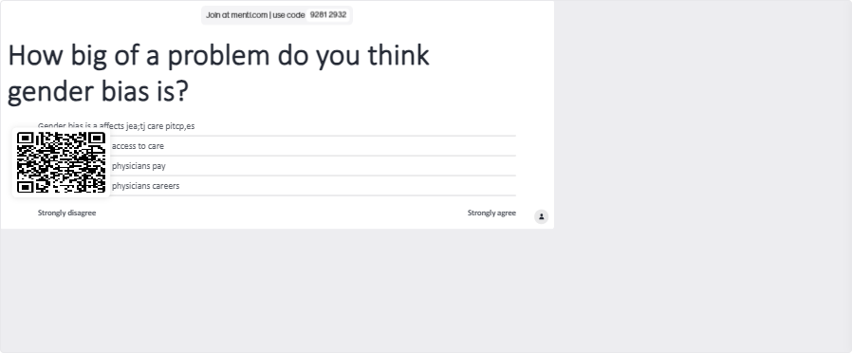
What do you think?

Slide 7

Two aspects of Gender Bias in Medicine
Bias in health services
Bias in (Academic) Medicine
Notes:
https://journals.sagepub.com/doi/10.2217/17455057.4.3.237

Slide 8
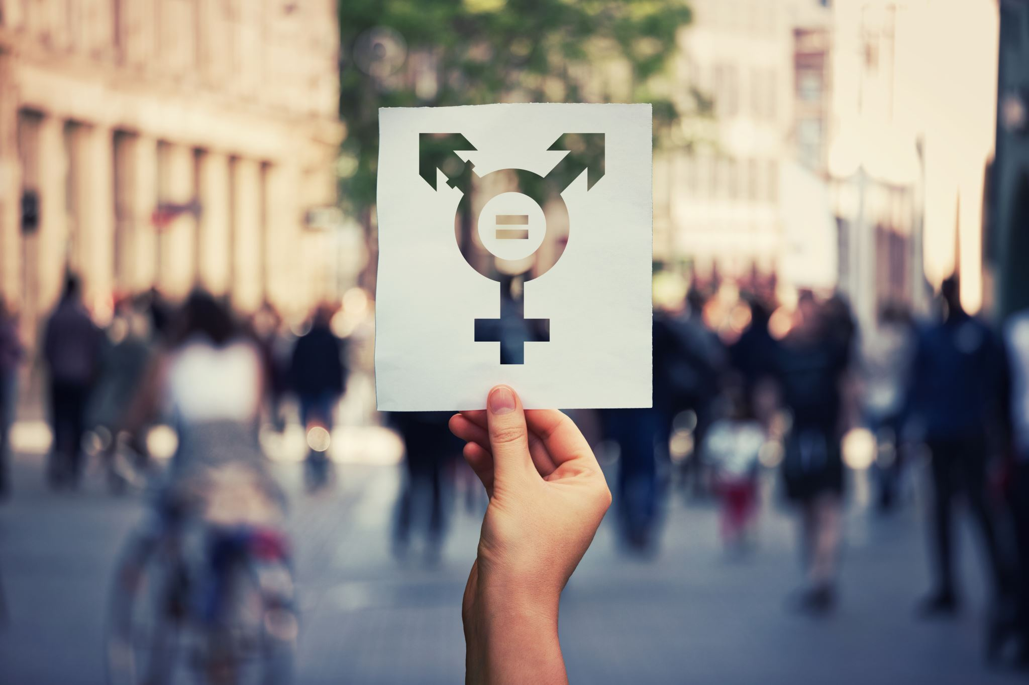
Gender bias defined
Gender bias is a preference for one gender over another. This preference is often based on false beliefs or generalizations that make one gender seem better or worse than others.
Worldwide, the most common form is bias against women. In 2020, a United Nations global report found that close to 90% of all people have some form of gender bias against women.
(UNDP, 2020)
Notes:
UNDP (United Nations Development Programme). 2020. 2020 Gender Social Norms Index (GSNI): Tackling Social Norms: A game changer for gender inequalities. New York.

Slide 9
What is gender bias?
In health care, the literature related to gender bias primarily refers to instances in which female patients are assessed, diagnosed, referred, and treated not only differently but at a lower level of quality or to a lesser degree of adherence to established standards of care than men with comparable health problems.
(UNDP, 2020)

Slide 10
“I was told I knew too much, that I was working too hard, that I was stressed out, that I was anxious,” said Ilene Ruhoy, a 53-year-old neurologist from Seattle, who had head pain and pounding in her ears.
Despite having a medical degree, Ruhoy said she struggled to get doctors to order a brain scan. By the time she got it in 2015, a tennis ball-sized tumor was pushing her brain to one side. She needed surgery, but first, she rushed home, hugged her 11-year-old daughter and wrote her a letter to tell her goodbye”
Bever, 2024. From Heart disease to IUDs” How doctors dismiss women’s pain. https://www.washingtonpost.com/wellness/interactive/2022/women-pain-gender-bias-doctors/
Notes:
Another was ignored as she cried out in pain during a 33-hour labor. She was supposed to be getting pain medication through her epidural, but it had fallen out.
Dozens of women complained of torturous pain as their vaginal walls were punctured during an egg retrieval process. They were told their pain was normal, but, in actuality, they were getting saline instead of anesthesia.
These are just some of the stories of women who say their pain and suffering has been dismissed or misdiagnosed by doctors. Although these are anecdotal reports, a number of studies support the claim that women in pain often are not taken as seriously as men.

Slide 11

Discussion
How does hearing about this make your feel?
  Why?
Why do you think gender bias happens?
Why does it still exist?
Notes:
VAlerie

Slide 12
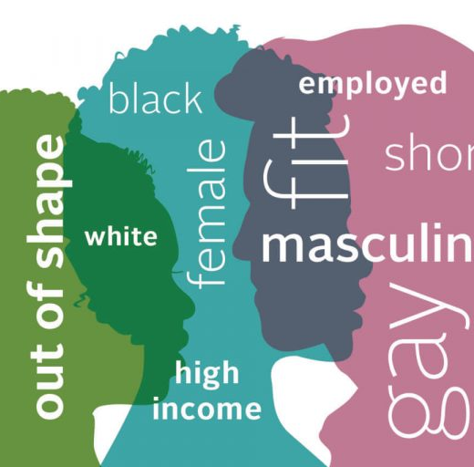
Implicit bias
Unconscious, outside our control
Automatic
“Mindbugs”
  Erroneous thought that stick in our minds even though we consciously “know better”
Lead to perceptual bias
Influence how we see, feel, remember, “know”, judge
Are learned associations
This Photo by Unknown Author is licensed under CC BY-NC-ND
(Banaji & Greenwald, 2013)
Notes:
Banaji, M. R., & Greenwald, A. G. (2013). Blindspot: Hidden biases of good people. New York: Random House Publishing Group.

Slide 13
Types of Implicit bias
Gender (today)
Race
Religion
Sexual identity
Gender identity
Age
Weight/Physical attributes
Others?
Notes:
VAlerie
What other types of bias might be implicit

Slide 14
Implicit bias happens in health care
HCP have same levels of implicit bias as general population
Influence diagnosis and treatment decisions
Influence level of care
Biases included:
Race/ethnicity
Gender
SES
Age
Mental Illnesses
Weight
Disability
Influence academic medicine
(FitzGerald & Hurst, 2017)
Notes:
Valerie
FitzGerald C, Hurst S. Implicit bias in healthcare professionals: a systematic review. BMC Med Ethics. 2017 Mar 1;18(1):19. doi: 10.1186/s12910-017-0179-8. PMID: 28249596; PMCID: PMC5333436.

Slide 15
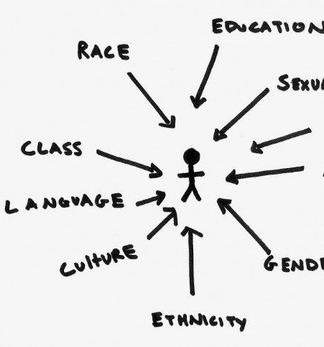
Bias Compounded by ‘Intersectionality’
Intersectionality is how being more than one of these groups affects a person.
In Academia:
“At the turn of the 21st century, there were 176,485 tenured full professors at the nation’s public and private research universities—72 percent White men, 17 percent White women, 8 percent men of color (Black, Hispanic, and Native American combined), and 2 percent women of color—combined”
(Evans, 2007, 131).
This Photo by Unknown Author is licensed under CC BY

Slide 16
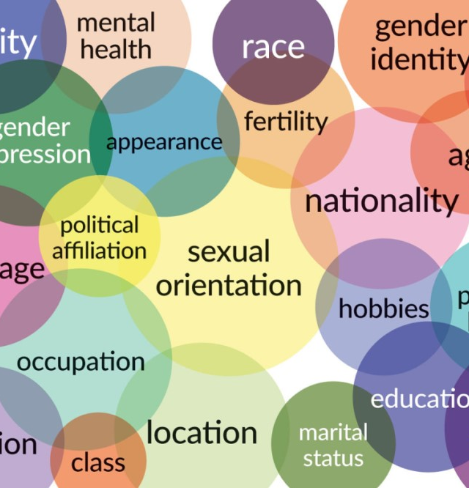
Intersectionality
Kimberlé Williams Crenshaw:
  Intersectionality is simply a prism to see the interactive effects of various forms of discrimination and disempowerment.
  It looks at the way that racism, many times, interacts with patriarchy, heterosexism, classism, xenophobia — seeing that the overlapping vulnerabilities created by these systems actually create specific kinds of challenges.
  Systems of inequality (including Healthcare) based on gender, race, ethnicity, sexual orientation, gender identity, disability, class and other forms of discrimination “intersect” to create unique dynamics and effects.
Notes:
Valerie
The interconnected nature of social categorizations such as race, class, and gender as they apply to a given individual or group, regarded as creating overlapping and independent systems of discrimination or disadvantage
Exposing [one’s] multiple identities can help clarify the ways in which a person can simultaneously experience privilege and oppression. For example, a woman who black does not experience gender inequalities in exactly the same way as a white woman, nor racial oppression identical to that experienced by a Black man. Each race and gender intersection produces a qualitatively distinct life.

Slide 17
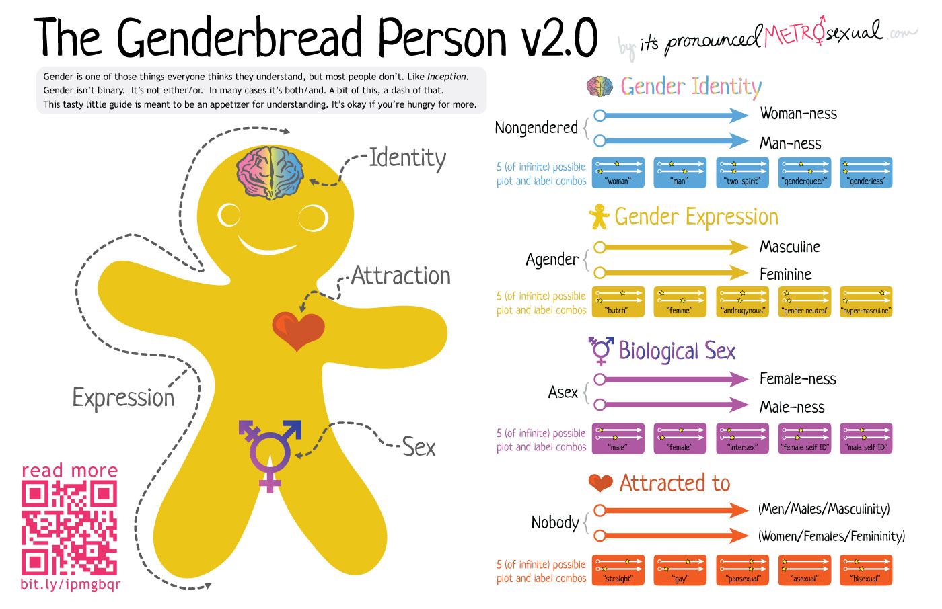
Before we discuss gender!
This Photo by Unknown Author is licensed under CC BY-NC-ND

Slide 18
Care domains related to …
Sex-specific care: Care related to health needs that are unique to women (and trans men), such as pregnancy and menopause. (biological basis?)
Sex-aware care: Care for conditions that are diagnosed or treated differently in women (and trans men) as compared to men (and trans women), such as heart disease and neurodegenerative diseases. (biological basis?)
Gender-sensitive care: Care provided in ways that are inclusive of gender-specific preferences, - 2SLGBTQIA health needs (sociological basis?)
(Zephyrin et al., 2022)
Notes:
Joanne
This is a the definitions from Zephyrin – which pose some challenges – we added the items in parathesis…but that might not fit for everyone. Language can be challenging and is always evolving.
When we talk about gender bias in health care – some of these issues are intertwined. Gender bias occurs against female presenting (women and trans women). Yet there are also sex related biases, like the lack of research that includes the female sex – or the lack of understanding of female differences in biology and physiology.

Slide 19
Gender Bias:
Impact on Patient Care
Gender-based bias in direct care
Gaps in Medical Research
Politicization of women’s health
Undersupply of women’s health specialists
(Zephyrin et al., 2022)
Notes:
Tothisend,over1.8millioncaregivernotes(502millionwords) fromalargeUShospitalwereevaluatedwithnaturallanguageprocessingtechniquesinsearchofgenderandethnicitybiasindicators. Consistentwithnonlinguisticevidenceofbiasinmedicine,physiciansfocusedmoreontheemotionsofwomencomparedtomenand focused more on the scientific and bodily diagnoses of men compared to women
"Gender bias in health care may be harming women." UWIRE Text, 2Feb. 2016, p. 1. Gale OneFile: Health and Medicine, link.gale.com/apps/doc/A442909125/HRCA?u=univmanitoba&sid=bookmark-HRCA&xid=d6a3d377. Accessed 6 May 2024.

Slide 20
Gender bias in direct care

Slide 21

Bias can be seen in:
Dis-belief in symptoms
  Particularly pain
Bias in documentation
  ?mirrors bias in care provision?
Inadequate treatment/management
Delayed and mis-diagnosis

Slide 22
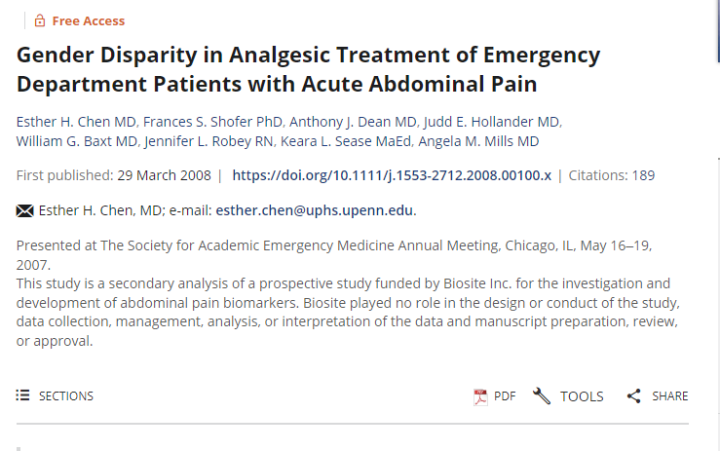
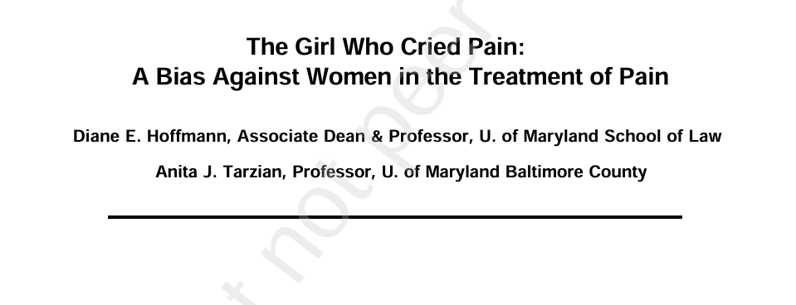
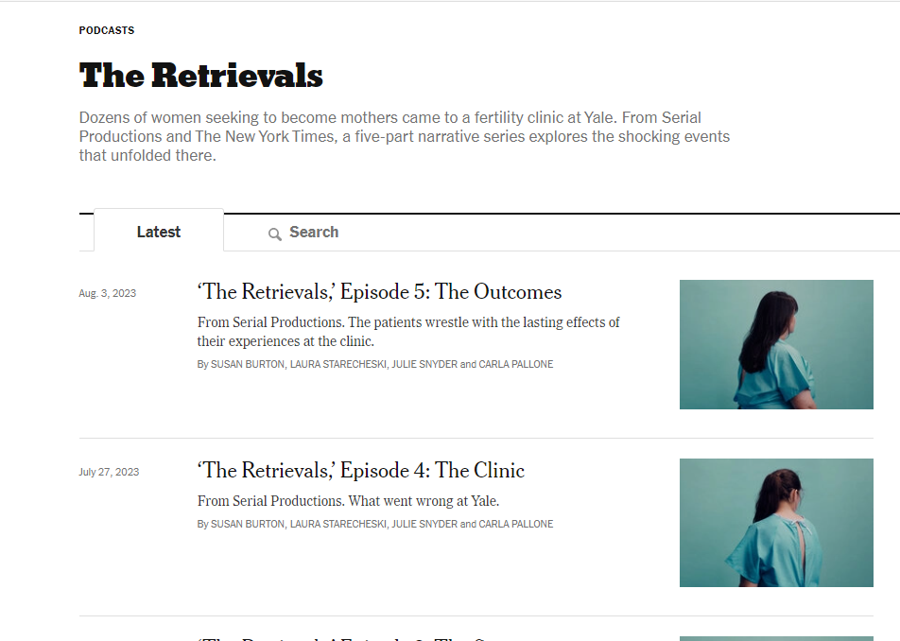
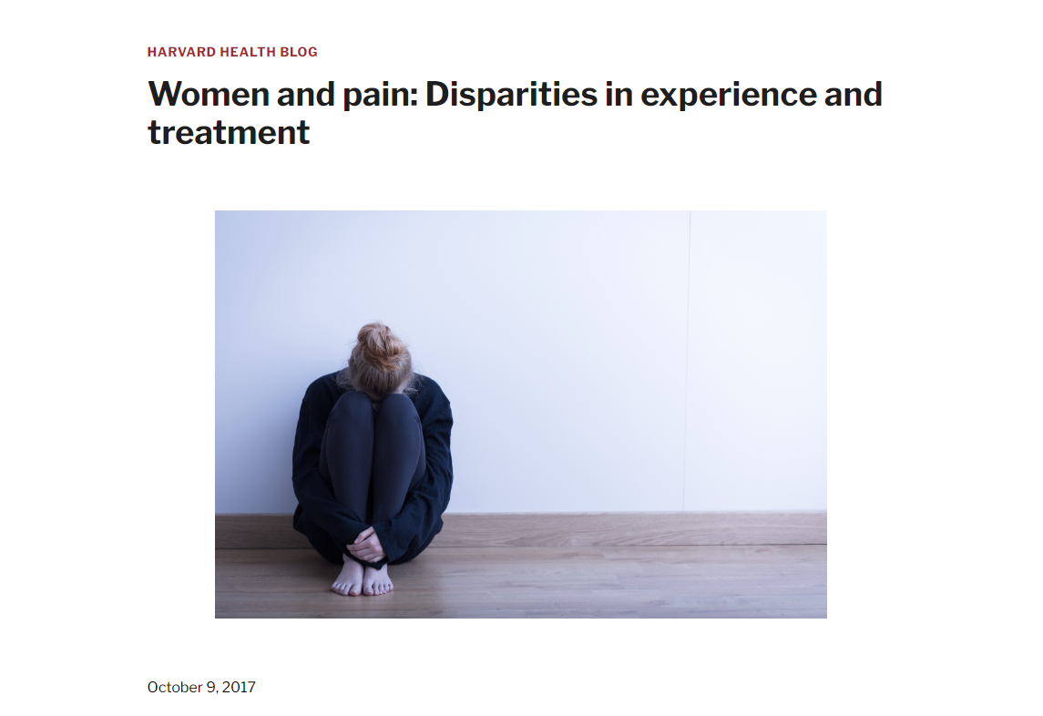
Dis-Belief in Symptoms
Down-play concerns
  Women with knee pain are 22 times less likely to be referred for a knee replacement than men (Borkhoff, 2008)
  Female health problems due to psychosocial causes…
Pain (Zhang, et al. 2021)
  Often Ignored
    After coronary bypass
    For chest pain
    IVF Egg retrievals (The Retrievals, 2020)
Treatment Delayed (Pope, 2000)
  65 minutes vs 49 minutes for men (33% longer)
  More likely to be Prescribed sedatives than pain med (Zhang, et al., 2021)
Notes:
Zhang, L., Losin, E. A. R., Ashar, Y. K., Koban, L., & Wager, T. D. (2021). Gender biases in estimation of others’ pain. The journal of pain, 22(9), 1048-1059.
After coronary bypass – only half as likely to be prescribed painkillers as men (get ref - https://www.upi.com/Archives/1989/03/11/Researcher-says-women-less-likely-to-get-painkillers/2047605595600/
Frequently, women’s concerns are dismissed or perceived as being less severe than men’s. Negative encounters with the health system — from inconvenience to disrespect and abuse — have been shown to suppress a willingness to seek care in the future.³⁷ Notably, clinicians respond differently to women’s reports of pain or discomfort than men’s and observe different treatment practices, such as prescribing sedatives to women and narcotics for men.³⁸ Women are more likely than men to receive referrals to psychologists to address nondescript symptoms and are less likely than men to receive pain medication or interventions. Women who present with heart attack symptoms are often sent home with a diagnosis of stress or panic disorder rather than being given the full cardiovascular diagnostic workup that is more consistently offered to men.³⁹
Dr. Powell, who is also the director of the Montefiore Einstein Center for Bioethics, speaks from experience: “A while back, I lost 10 pounds over a couple months, so I went to my doctor and told him I thought it was a sign I was having a recurrence of an old illness. He gave me a few reasons he disagreed and added, “Plus you’ve been on a diet.” That struck her as odd — she had never said this, and doubted her doctor would have made the same assumption about a male patient. A set of tests with a new physician confirmed that Dr. Powell was correct about the recurrence of a previous illness, for which she was immediately treated. From https://www.nytimes.com/2018/05/03/well/live/when-doctors-downplay-womens-health-concerns.html
Our cultural image of the mother as martyr rears its ugly head here, placing women in a position where they undergo excruciating pain for their potential children. There is a deeper failure here, however, in that pain management is not just administered for patients’ comfort but their safety. With a long needle in the pelvic cavity, sudden movements and spasms present a serious risk, one that the team at Yale should have addressed immediately. Instead, they continued, even discharging women expressing severe pain after their retrieval, a sign that something may have gone wrong. In the second half of the podcast, Burton moves to a case-study style assessment of institutional accountability at Yale by following a lawsuit brought by 70 patients against the clinic and conducting anonymous interviews with staff. Here, we learn that this is not just a story about Monticone. We learn that Yale, an institution with a then-$31.2 billion endowment, did not have a Pyxis, a medication dispensing machine that records each transaction. Nor did they provide propofol, a deeper sedative commonly used in egg retrievals. Instead, when met with increased reports of pain, Yale sent a doctor to speak to staffers about being more empathic during procedures, never investigating other reasons for these reports like the drug supply.

Slide 23
Pain:
“Brave Men” vs “Emotional Women”
When describing men and women with pain
Stoic men
“Brave and manly”
The ‘strong body’
Hysterical and Emotional women
“I have to learn to live with pain”
Seen as fabricating/exaggerate pain
Gender bias in treatment of pain
Women struggle for legitimacy
Women more often judged by appearance
Women received less, and less effective, pain relief (and more anti-depressants)
Bias in research writing around men and women:
(Samulowitz, 2018)
Notes:
Anke Samulowitz, Ida Gremyr, Erik Eriksson, Gunnel Hensing, "“Brave Men” and “Emotional Women”: A Theory-Guided Literature Review on Gender Bias in Health Care and Gendered Norms towards Patients with Chronic Pain", Pain Research and Management, vol. 2018, Article ID 6358624, 14 pages, 2018. https://doi.org/10.1155/2018/6358624
The selected 77 articles were published in 39 different journals, with studies published in journals specialized in pain dominating (32 articles). Different kinds of research design were represented, including quantitative and qualitative studies, reviews, and articles on theory development. However, only one of the studies with a qualitative design was published in a journal specializing in the field of pain. The distribution of the included articles over the 15 years varied between one and 12 articles/year, without any notifiable trend over time. All articles were conducted in high income countries—the United States, Canada, Western Europe, Australia, New Zealand, and Japan. Diagnoses that were examined included back pain (14), neck pain (5), musculoskeletal pain (9), fibromyalgia syndrome (5), osteoporosis (3), rheumatoid arthritis (2), ankylosing spondylitis, and headache. An overview over the included articles is presented in Table 1.
The description of the “stoic man” was the same, whether it was given by researchers [2, 8, 14, 51–53], men with pain [43, 45, 46, 54, 55, 57, 59], or health-care professionals [13, 44].
The reviewed studies showed that women with pain can be perceived as hysterical [8, 13, 69–71], emotional [13, 49], complaining [49, 72], not wanting to get better [71, 73–75], malingerers [71, 73], and fabricating the pain, as if it is all in her head [47, 49, 71, 74, 76]. Other studies showed that woman with chronic pain rather are assigned psychological than somatic causes for their pain [13, 22, 47, 49, 69–71, 74–79].

Slide 24
Bias in Charting
Physicians writing about men focused more on their body (e.g. words such as spine and skull) than physicians writing about women (P<0.001).
  The man received the following physician note, “S/P AVR with 5/10 incisional pain, grimacing with CDB and at rest,” which contains two negative emotion terms (pain and grimacing).
  The woman received the following physician note, “Extremely anxious, crying and becoming very worked up. Patient cannot state what exactly the problem is but cries and exclaims help me and oh dear repetitively,” which contains four negative emotion terms (anxious, crying, problem, and cries).
Collectively, the emotion and body words data reveal disparities in attention as modified by patient gender: physicians psychologically focus more on emotion when they attend to women (compared to men) and more on the patient’s body when they attend to men(compared to women).
( Markowitz, 2022)
Notes:
David M Markowitz, Gender and ethnicity bias in medicine: a text analysis of 1.8 million critical care records, PNAS Nexus, Volume 1, Issue 4, September 2022, pgac157, https://doi.org/10.1093/pnasnexus/pgac157

Slide 25
Bias in charting…..
Consider the following excerpts from patients who had the same caregiver, a similar diagnosis, and were the same ethnicity (White), but different gender.
The man received the following physician note, “S/P AVR with 5/10 incisional pain, grimacing with CDB and at rest,” which contains two negative emotion terms (pain and grimacing).
The woman received the following physician note, “Extremely anxious, crying and becoming very worked up. Patient cannot state what exactly the problem is but cries and exclaims help me and oh dear repetitively,” which contains four negative emotion terms (anxious, crying, problem, and cries).
Another excerpt from the same caregiver toward a White woman suggested, “Pt extremely nervous and anxious throughout shift. Pt has fear that she is going to fall OOB and uneasy about all nursing care,” which contains four negative emotion terms (nervous, anxious, fear, and uneasy).
In contrast, a man was described as “Pt pleasantly confused,” with one negative emotion term (confused), a note that is still generally positive.
( Markowitz, 2022)
Notes:
David M Markowitz, Gender and ethnicity bias in medicine: a text analysis of 1.8 million critical care records, PNAS Nexus, Volume 1, Issue 4, September 2022, pgac157, https://doi.org/10.1093/pnasnexus/pgac157

Slide 26
Bias in charting
Physicians thought in more analytical and structured terms (e.g. using more articles and prepositions relative to pronouns and storytelling words) when attending to men compared to women(P<0.001).
  A physician attending to a Black man wrote, “Sinus rhythm with atrial premature beats. Since the previous tracing probably no significant change other than the atrial premature beats,” which scored high on the analytic thinking index (98.58).
  A physician attending to a Black woman patient with the same diagnosis stated, “Irregular sinus tachycardia Septal + lateral ST-T changes cannot exclude myocardial ischemia,” which scored lower on the analytic thinking index (62.04)
( Markowitz, 2022)
Notes:
A critical reader might question if the reported effects are indeed a reflection of bias, or perhaps other psychological, institutional, or communication processes. There are several reasons why the effects are likely bias instead of other alternatives. First, the evidence in this paper is consistent with patterns of gender and ethnicity bias observed in other work. Language patterns, therefore, are another way that bias is represented at scale and naturally, from actual patient–physician records. Second, the effect sizes are small, which is consistent with how gender and ethnicity bias is generally communicated or revealed in the wild.

Slide 27
What do you think are the implications of the differences in charting?

Slide 28
Inadequate Management (selected examples)
Peripheral arterial disease
Less likely to receive anti-platelet, beta-blocker, or lipid lowering therapies for PAD or CVD. (Enriquez, 2008; Miller, 2000)
Less likely to be offered option of surgical revascularization (Poisson, 2010; Vouyouka, 2010)
Acute respiratory Distress syndrome (ARDS) (Lat, 2021)
More likely to experience ventilator-induced lung injury
Higher mortality rates
Sepsis (Lat, 2021)
Longer wait to initiation of antibiotics
Septic bundles less likely to be completed
Increased mortality
Diabetes
85% of men vs 55% of women received OHAs. (Branstrom, 2011)
Trauma (Lat, 2021)
Male trauma patients more often given priority 1, transported straight to trauma center, and allocated highest level of prehospital competence than females. Differences by sex remained after adjusting for age, type and mechanism of injury, and prehospital cardiac arrest.

Slide 29
Delayed and Mis-Diagnosis
Altered Health seeking behaviours
Avoidance of care due to lack of trust
Consequence of Disbelief in symptoms
Misdiagnosed (Westergard, 2019)
AMI – 7x less likely to be correctly diagnosed
RA – lag to diagnosis – waited 7 weeks longer than men
Slower admission to ICU (Lat, 2021)
Delayed Diagnosis
E.g. Female gender is independent risk factor for delayed referral and diagnosis of bladder and renal cancer.(Lyratzopoloulus, 2013)
a study analysing health data for almost 7 million men and women in the Danish healthcare system over a 21-year period, and showing that women were diagnosed later than men in more than 700 diseases

Slide 30
This is despite concerted efforts to improve guidelines….
AHA’s first Scientific Statement on Acute MI in Women notes that “despite dramatic declines in cardiovascular deaths among women over the past decade . . . women still fare worse than men.”
Compared to men, women tend to be underdiagnosed, undertreated, and less likely to receive guideline-recommended medications.
(Mehta, et al., AHA, 2016)
Notes:
Mehta LS, Beckie TM, DeVon HA, et al, for the American Heart Association Cardiovascular Disease in Women and Special Populations Committee of the Council on Clinical Cardiology, Council on Epidemiology and Prevention, Council on Cardiovascular and Stroke Nursing, and Council on Quality of Care and Outcomes Research. Acute myocardial infarction in women: a scientific statement from the American Heart Association. Circulation. 2016;133:916-947.

Slide 31
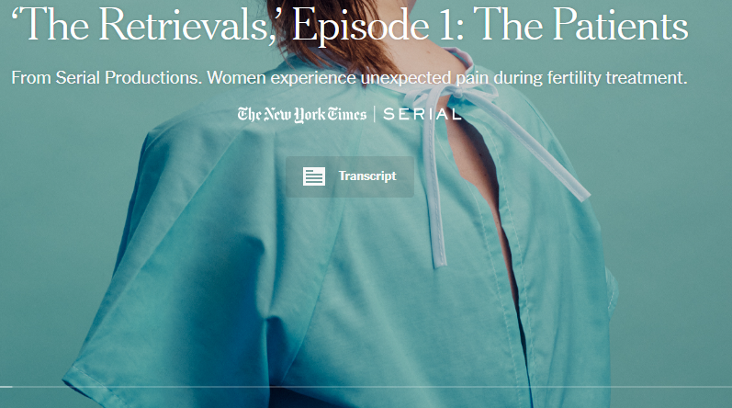

Notes:
The retreivals – the patients – 5:00 =

Slide 32
Discussion:
Why did this happen?
What do you think were contributing factors?
Why did no one believe the women?
How do we prevent this?

Slide 33
Case Discussion
You are a clerk on the ward as part of a team caring for an 80 y.o Black female patient admitted for a non-stemi MI. The patient has a history of afib, RA, and OA. Surgical hx includes hip replacement and knee replacements and total hysterectomy at age 40.
The patient reports severe abdominal pain, exacerbated by eating. She is given OTC painkillers for the pain and told “that it should settle down. It is likely caused by anxiety.”
Over the course of the admission, the patient’s pain continues. As the patient has a history of gallstones, imaging of the gall bladder is ordered. Imaging shows no stones present.
Although the patient’s pain continues, as ‘no pathology was found’, the patient was discharged home.

Slide 34
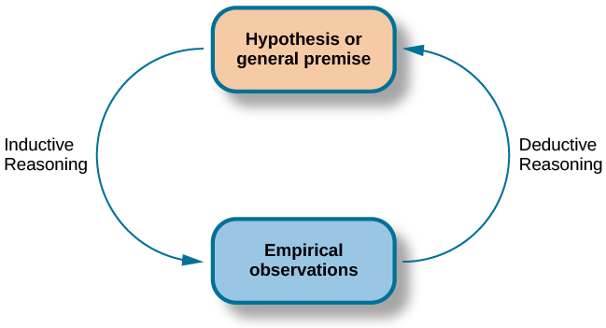
What do you might be going on?
This Photo by Unknown Author is licensed under CC BY

Slide 35
Case Discussion
You are a clerk on the ward as part of a team caring for an 80 y.o Black female patient admitted for a non-stemi MI. The patient has a history of afib, RA, and OA. Surgical hx includes hip replacement and knee replacements and total hysterectomy at age 40.
The patient reports severe abdominal pain, exacerbated by eating. She is given OTC painkillers for the pain and told “that it should settle down. It is likely caused by anxiety.”
Over the course of the admission, the patient’s pain continues. As the patient has a history of gallstones, imaging of the gall bladder is ordered. Imaging shows no stones present.
Although the patient’s pain continues, as ‘no pathology was found’, the patient was discharged home.
The patient shows up two days later in the ED with severe abdominal pain. The ED Physician reviews the imaging from the admission - it shows a total occlusion of the superior mesenteric artery. The patient, a retired nurse, notes that she had raised the issue of an ischemic bowel with her team, which was ignored.

Slide 36
Why was this missed?
Case example PAD
(Kavurma, 2023)

Slide 37
Key clinical and health system variables: PAD
Area | Variables
Health provider awareness | Bias of male predominance in PAD
 | Low awareness of female PAD (less likely to recognize in women)
 | Misdiagnoses
Low health literacy & PAD awareness | Poor awareness of PAD risk & preventative strategies, amplified by intersectionality
 | Minimize symptoms, less likely to discuss with practitioners
Inadequate diagnostic criteria | Lower ankle-brachial index (ABI) ratios than men
 | ABI ratio as a measure of functional impairment inconsistent btw the sexes
 | Discrepancy in self-screening questionnaires
Evidence Paucity | Under-representation in clinical trials
 | Lack of standardization in gender-related differences reported in clinical trials
(Kavurma, 2023)
Notes:
Kavurma, M. M., Boccanfuso, L., Cutmore, C., Passam, F., Patel, S., Hennessy, A., ... & Aitken, S. (2023). A hidden problem: peripheral artery disease in women. European Heart Journal-Quality of Care and Clinical Outcomes, 9(4), 342-350.
Healthcare provider awareness Disease literacy and awareness of PAD risks are poor amongst women and healthcare providers, and healthcare providers are less likely to recognize PAD in women compared with men. Although
women consult general practitioners at similar rates to men prior to their diagnosis with PAD, they are more likely to be misdiagnosed with other conditions, including musculoskeletal disorders. Unfamiliarity and a lack of knowledge could contribute to under-recognized symptoms and mismanagement of disease.
Diagnostic criteria: Although there are reports that healthy women have a lower ABI than men,70 the association of lower ABIs with functional impairment in PAD is inconsistent between the sexes.71 This may be due to multiple factors, including calf-muscle size, which could influence occlusion pressures or that women present with atypical disease and are less likely to align with clinical staging criteria.20 There is also a significant discrepancy between the PAD symptoms women report on self-screening questionnaires and the symptoms scored by treating doctors, but less so for men,72 highlighting differences in perception between the sexes.
Evidence paucity
Publication of data that lacks gender, racial, and ethnic diversity can result in clinical care that is not applicable and may be less effective or even harmful to identified groups of the population. Women represent only ∼33% of study participants in trials of intervention for PAD in the last 10 years (Figure 2). Poor representation of women in clinical trials is multifactorial and complex to address. For PAD clinical trials, poor enrolment of women may be exacerbated by inclusion criteria, but also by social and clinical factors elaborated on in this review. To improve gender diversity in clinical research, Steinberg et al. propose a standardized system of reporting sex-dependent changes in pathogenesis, prognosis, or treatment outcome, including those individuals who are transgender or non-binary.
While this focuses on clinical and healthsystem variables – there are also social variables - The social structures that women live, work, and relate to are important system factors that contribute to overall gender inequality but can also impact gendered differences in PAD. These include the socioeconomic determinants of disease, the value and role of women in society, and geographical patterns associated with disease (Table 4). Direct causal evidence for social drivers of inequality is limited. In this section, we present associations with social factors that drive inequality in health in general, applying it to what is known about PAD.

Slide 38
What can we do?
There are few research studies describing/evaluating interventions to address gender bias in health care:
  Address knowledge mediated gaps!
  Develop decision support tool – to implement guidelines and standardized protocols
    Most common researched approach
  Training for staff, clinic, and community
  Interventions managed by an all women team for female patients (?)
  Gender sensitive improvements in data collection
  Routine screening for gender violence
  Appropriate representation of women in clinical trials
    Including non-binary and transgender women
(Alcade-Rubio, et al., 2020)

Slide 39

Knowledge mediated bias
Bias can happen when gaps in care arise from deficiencies in knowledge rather than explicit provider bias.
Are systems of discrimination
Are intersectional
  Race
  (dis)ability
  SES
  Others…
This Photo by Unknown Author is licensed under CC BY-SA-NC

Slide 40

Women’s Health in UGME – so far
What is your experience learning about Gender based differences in care in UGME
https://www.research.net/r/WHUGMEtest

Slide 41

Gaps in training
Inadequacy of medical education and training addressing gender:
  Little training on women’s health needs
  Less than 30 percent of medical schools incorporate gender-specific topics in their curriculum
  9 percent of medical schools offer women’s health courses or electives.
Poor awareness of the sex differences in disease progression and treatment and
A lack of awareness of pivotal health experiences that women encounter. For example, menopause
(Zephyrin, et al., 2020)
Notes:
Need to summarize this
Zephyrin, L., Suennen, L., Viswanathan, P., Augenstein, J., & Bachrach, D. (2022). Part 1: A framework for addressing gaps and barriers. (Commonwealth Fund and Manatt Health, https://doi.org/10.26099/8c0s-fj12
www.aacnnursing.org/Portals/0/PDFs/Teaching-Resources/HRSA-Womens-Health-Curricula-Report.pdf

Slide 42

Undersupply of women’s health specialists

Slide 43
Undersupply in ….
Shortages in specialty services, such as:
  Mature women’s clinic
  Perinatal psychiatrists
  Gynecology
Shortage of specialists with training in women’s health issues, such as
  Cardiologists
  Oncologists
  Neurologists
  Others….
Lack of racial/ethnic diversity among women’s health specialists
(Zephyrin, et al., 2020)

Slide 44

Gaps in Medical Research
Notes:
According to the AAMC, Before 1993, women were rarely included in clinical trials. Today, the medical field still doesn’t know how well many drugs and devices work for women. https://www.aamc.org/news/why-we-know-so-little-about-women-s-health

Slide 45
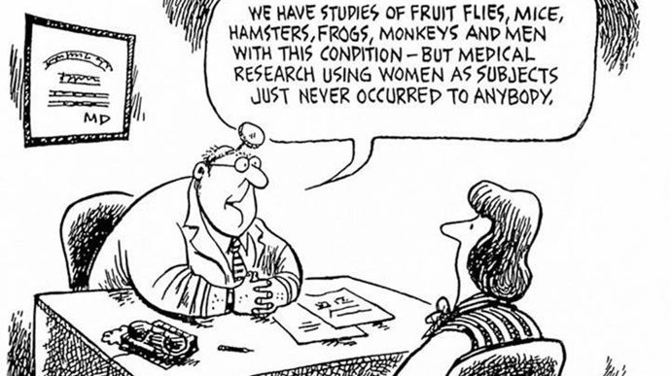

Slide 46
Gaps in Medical Research
E.g. Cardiovascular disease
Hearts smaller, have smaller coronary artery lumens, respond differently to exercise and to cardiac drugs
Less than 25% present with AMI present with angina
46% present with no chest pain at all.
Yet…
Study on aspirin and CVD.
22,000 participants but no women
Three subsequent female cohort revealed conficting data about efficacy
Still - Aspirin prescribed to both men and women with little evidence of its safety or efficacy in women
Notes:
reference

Slide 47

Gaps in Medical Research
In areas of women’s health (menopause, PCOS, Endometriosis) (Balsch, 2024)
On Pregnant women (Lat 2021)
HIV and other disease specific conditions (Goldstein, 2019)
  Women of reproductive age excluded until 1993
  Currently only 40% of all clinical trial participants (Balch, 2024)
Notes:
Goldstein, R. H. & Walensky, R. P. (2019). Where Were the Women? Gender Parity in Clinical Trials The New England Journal of Medicine, 381 (26), 2491-2493. doi: 10.1056/NEJMp1913547.
There are limited evidence-based reasons for excluding people from trials on the basis of gender. Just this year, the FDA posted draft guidelines on the inclusion of men in studies of new breast-cancer therapeutics, citing prior exclusion as a barrier to effective treatment options. Men account for less than 1% of all breast-cancer cases, but under these guidelines, the “FDA does not intend to consider low expected accrual rates of male patients with breast cancer to be a sufficient scientific rationale for excluding them from a clinical trial.”5 Meanwhile, in the same month these guidelines were published, the FDA advisory committee reviewed data on F/TAF for HIV prevention that intentionally excluded women — a population that accounts for nearly 20% of all new HIV infections in the United States and 46% of all infections globally. The manufacturer justified its decision by citing difficulty in identifying “a relevant female cohort.”2

Slide 48
Discussion: Gender Bias in Research
What are the implications of lack of participation by women in clinical research?
What do you think are the implications for research primarily done on White males?

Slide 49

Politicization of Women’s Health
Abortion
Family planning
Counselling on reproductive health
Results:
Stigmatization and reduced willingness to seek care
Reduced access to care
(Zephyrin, et al., 2020)
This Photo by Unknown Author is licensed under CC BY

Slide 50

Gender bias in Academic Medicine
Lack of women in leadership
Pay in-equity
Career ‘options’
Bullying, harassment, and discrimination
(Bates, 2019; Salles, 2019)
Notes:
Valerie switch

Slide 51
Reviewing the Demographics
42% of the physician workforce in Canada is female
  54% of those under the age of 40
Despite this, overall underrepresented in academic medicine
  Women represent approximately 1/3 of academic physicians
Varies greatly by subspecialty
  8% of surgeons
  16.5% of cardiologists
  (Canadian Medical Assocation, 2018)
Notes:
CMA, (2018). Addressing gender equity and diversity in Canada’s medical profession: a review. Canadian Medical Association & Federation of Medical Women of Canada; 2018:16. https:// www. cma. ca/ sites/ default/files/pdf/Ethics/report-2018-equity-diversity-medicine-e. pdf.

Slide 52
Lack of Women in Leadership
Women remain underrepresented in senior faculty and leadership roles in academic medicine, in Canada as of 2016/17
  only 22% of professors,
  36% of associate professors and
  24% of medical school deans
Particularly challenging for racially marginalized women
(Bates, 2019; Yu, 2013; Templeton, 2020)

Slide 53
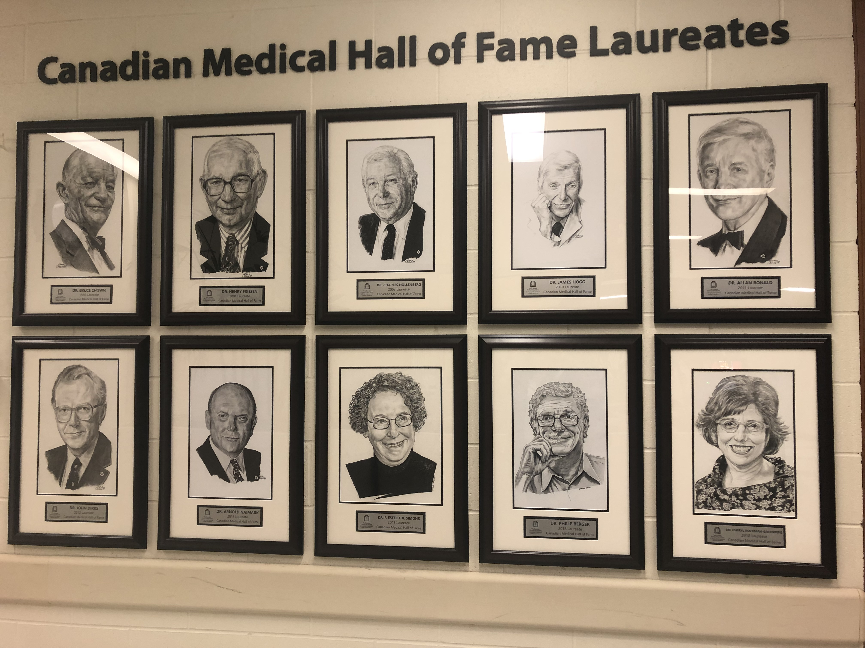

Have you ever noticed the portraits of past leaders on the walls?

Slide 54
Have you ever noticed the portraits of past leaders on the walls?
2 out of 8, or 25% female
What about the past Deans (pictures in A106)?
Or current Associate Deans?
  How many women?
  In what roles
  How would you characterize those roles?

Slide 55

Pay In-Equity
Pay in-equity
Billing codes for male vs female procedures
Female dominated specialties paid less (Cohen, 2020, Steffler, et al., 2021)
Pay gaps
15.6% pay gap, when accounting for hours work, when controlling for hours work, years in practice, specialty, and location (Glauser , 2020)
e.g. Draining vulvar abscess pays half of draining a scrotal abscess (Glauser, 2020)

Slide 56
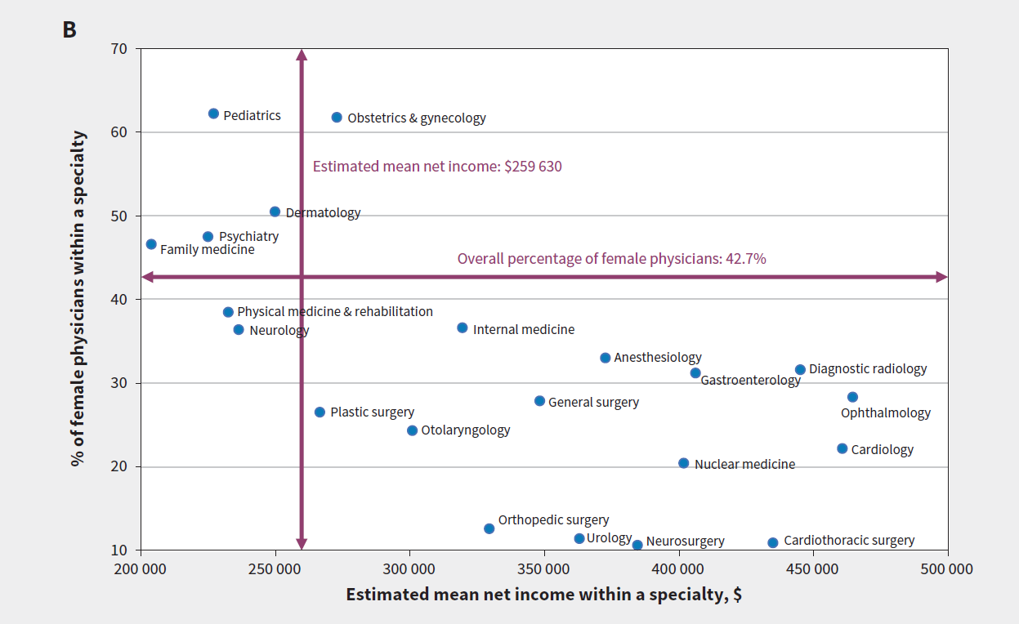
Need ref
Notes:
B) Scatterplot of the proportion of women in a specialty and the estimated average net income by specialty. Psychiatry includes geriatric psychiatry, child psychiatry and general psychiatry. Cardiac, cardiothoracic and thoracic surgery were combined into a single category. Pediatrics, internal medicine, and obstetrics and gynecology represent their general, but not subspecialty, categories

Slide 57
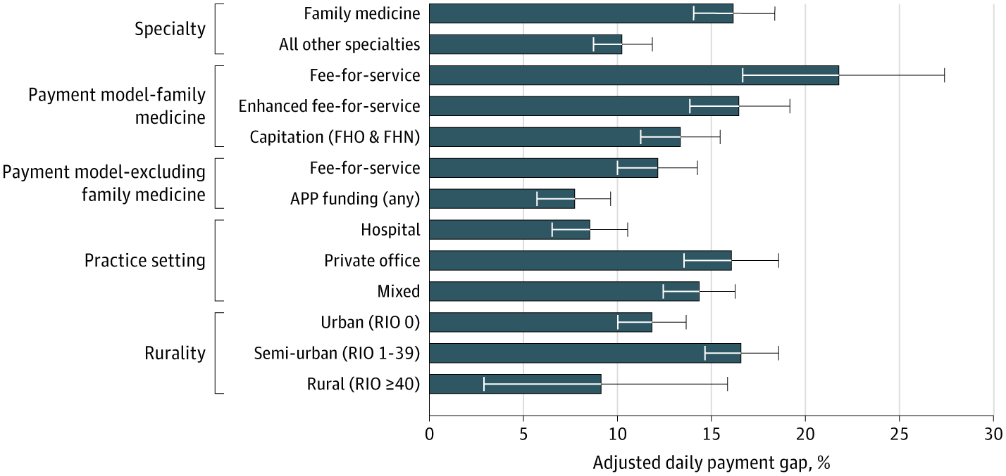
OMA - Pay – controlling for variables
(Steffler, 2021)
Notes:
Steffler M, Chami N, Hill S, Beck G, Cooper SC, Dinniwell R, Newbery S, Simkin S, Chang-Kit B, Wright JG, Kantarevic J, Weir S. Disparities in Physician Compensation by Gender in Ontario, Canada. JAMA Network Open 2021;4(9):e2126107. doi:10.1001/jamanetworkopen.2021.26107

Slide 58
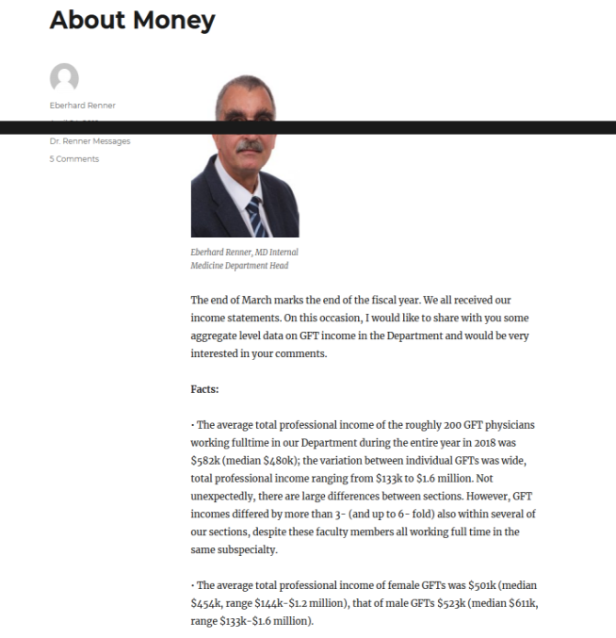
Locally – IM Pay in-equity
Notes:
LOOK AT SLIDE

Slide 59
Career ‘Options’
Implicit bias in selection limits career ‘options’ (Ruzycki, 2020; Salles, 2019)
  Men/surgery, women/family medicine
Underrepresentation in ‘competitive’ specialties
  e.g. critical care, surgery, etc (Vincent, 2021)

Slide 60

Medical School Faculty Applications
Letters of Recommendations for men:
  Longer
  More references to research
Letters of Recommendations for women
  Shorter
  More likely described as "caring", "compassionate“, "empathetic“, "bright" and "organized“
  More “doubt raisers”
  More references to teaching abilities vs research
Intersectional aspects
  White applicants were more likely described as "standout“
  Black applicants more likely described as "competent"
(Trix & Psenka, 2003)

Slide 61
Implicit bias
Unconscious, outside our control
Automatic
“Mindbugs”
  Erroneous thought that stick in our minds even though we consciously “know better”
Lead to perceptual bias
Influence how we see, feel, remember, “know”, judge
Are learned associations
This Photo by Unknown Author is licensed under CC BY-NC-ND
(Banaji & Greenwald, 2013)

Slide 62

Implicit bias: Affects on Men and Women
Implicit bias contributes to…
Bias in research grants
  recent study that explored gender difference in Canadian Institutes of Health Research awards found that less favourable assessments of women as principal investigators drove lower award rates, rather than the quality of their proposals. (Witteman, 2019)
Bias in publications
  Double-blind reviews led to significant increase of females as lead authors (Budden, Tregenza, Aarssen, et al. 2008)
Bias in selection
  Letters of reference, interviews,
Bias in pay
Challenging career path

Slide 63
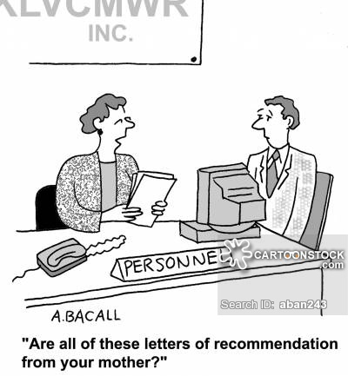

Slide 64
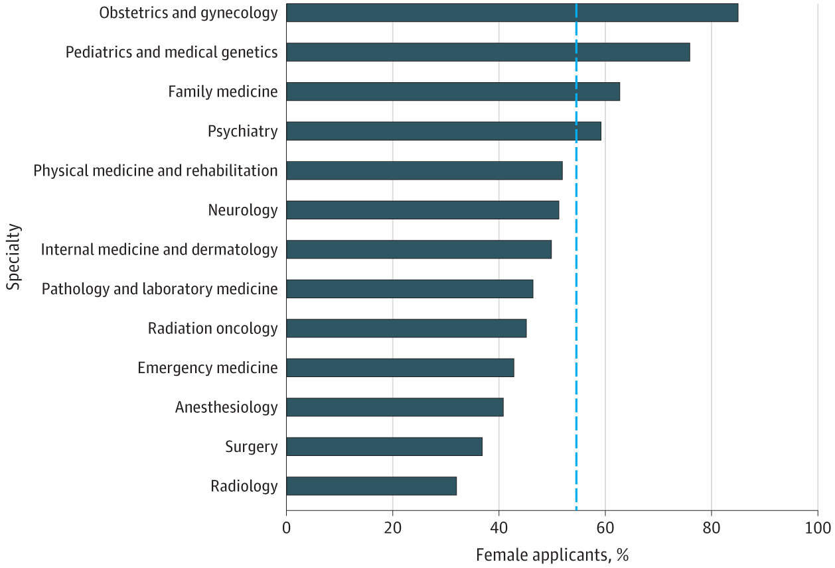
Match into R1 Entry programs: Canada
(Lorello, et al. 2020)

Slide 65
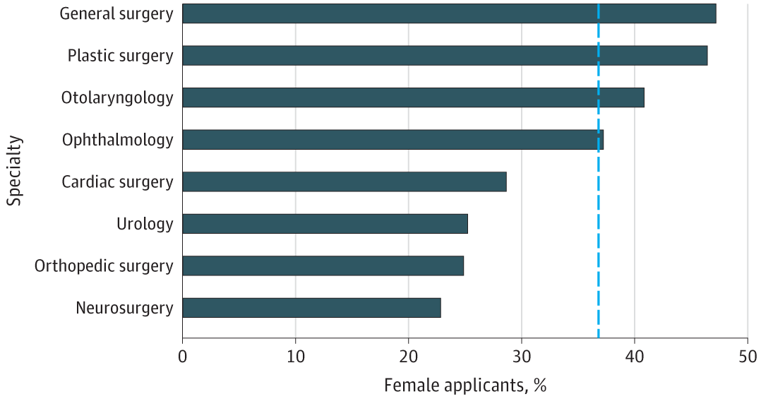
R1 Match – Surgical specialities
(Lorello, et al. 2020)

Slide 66
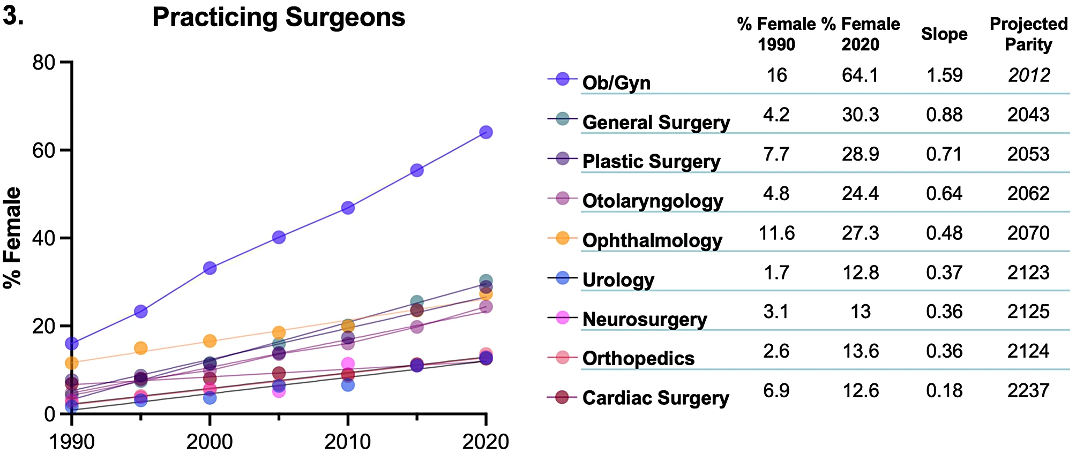
Canada: Proportion of practicing surgeons
(Bonddok, 2024)

Slide 67
So…..
Women have outnumbered men in Canadian medical schools for a quarter of a century
Not equally represented in leadership positions
Less likely to reach higher ranks than men
  Even after controlling for age, experience, productivity, and specialty
  Intersectional (race) worsens
CMA 2018 report- acknowledge that gender inequity among medical leaders an important problem
  Only 8 of the 152 past presidents were women
First woman dean of medical school in 1999
  170 years after first medical school established
  Only ~8 women deans since then
  UofM – no female dean since inception.
    Oldest school in Western Canada
(Bates, et al., 2016; Tricco, et al., 2021)

Slide 68

Factors perceived to have contributed to gender gap
Recruitment processes
  Process not systematic, and may induce bias
  Women may not have the same access to the informal recruitment networks that exist among men
  Personal experiences (positions were created for them, or they were personally invited)
  Lack of transparency
(Tricco, et al., 2021)
Notes:
Exploring gender gap further
Recruitment processes
Process not systematic, and may induce bias
Women may not have the same access to the informal recruitment networks that exist among men
Personal experiences (positions were created for them, or they were personally invited)
Lack of transparency

Slide 69

Factors perceived to have contributed to gender gap
Career Mentorship
  Difficult to find a mentor
      Unintentional biases
  No mentorship
      Wish they had it, especially in early years
(Tricco, et al., 2021)
Notes:
Career Mentorship
Most have informal mentorship experiences
Acquired mentors serendipitously
Difficult to find a mentor; unintentional biases
No mentorship: wish they had it, especially in early years

Slide 70
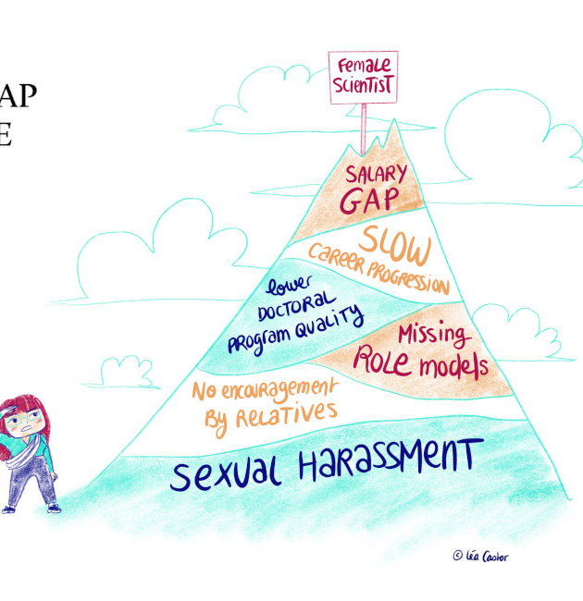
Factors perceived to have contributed to gender gap
Gendered roles and expectations
  Family roles
  Physician roles
  Patient expectations of physicians
It is not:
  Too few qualified applicants
  Women have different aspirations than men
This Photo by Unknown Author is licensed under CC BY-SA-NC
(Tricco, et al., 2021)
Notes:
Additional factors
Gender gap may reflect historical trends
Gender gap may dissipate over time as men retire and women advance in their careers
Gender gap may reflect smaller female candidate pool
Women may be less interested due to length of educational requirements and impact on work-life balance
Women may be interested but have not been able to advance their careers as quickly as men due to lifestyle choices

Slide 71
The Fallacy of Meritocracy
Meritocracy = the talented are chosen & moved ahead based on their achievement
  Most believe that meritocracy is the way the system should & does work
  However, research has shown this is not true!
  Implicit and Explicit bias!
Beware the argument that a focus on enhancing gender equity implies women are less competent / unable to make it on their own merits !!
(Barcelo & Shadravan, 2021)
Notes:
Barceló, N. E., & Shadravan, S. (2021). Race, metaphor, and myth in academic medicine. Academic Psychiatry, 45(1), 100-105.
Most believe that meritocracy is the way the system should & does work
Meritocracy = the talented are chosen & moved ahead based on their achievement
Thus, a focus on enhancing gender equity implies women are less competent / unable to make it on their own merits
“Lowering standards to fulfill a quota” (Etzkowitz et al. 1994, Norton and Sommers 2011)

Slide 72
Biased indicators of excellence
MSPR/Academic Transcripts and Records
MMI
CASPER
Personal Letter
Letters of Reference
The Personal Interview
Publications
Research grants
Years of service

Slide 73
Workplace bullying, harassment, and discrimination
Bullying, harassment, and discrimination still exists:
  Approximately 50% of female faculty report having experienced sexual harassment and 47–70% report gender-based discrimination (Car, et al., 2000)
  66% of physician mothers report experiencing gender-based discrimination (Adesove et al., 2017;)
Can be tacit
e.g. Speaker introductions at internal medicine grand rounds: forms of address reveal gender bias
  women introduced by men at grand rounds were less likely to be addressed by professional title than were men introduced by men.
  Differential formality in speaker introductions may amplify isolation, marginalization, and professional discomfiture expressed by women faculty in academic medicine. (Files, 2017)

Slide 74
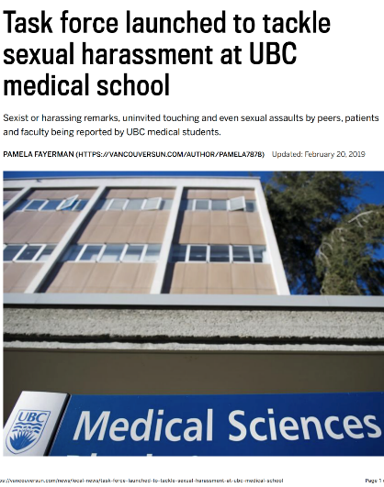
Vancouver Sun Feb. 20, 2019
Notes:
2019

Slide 75
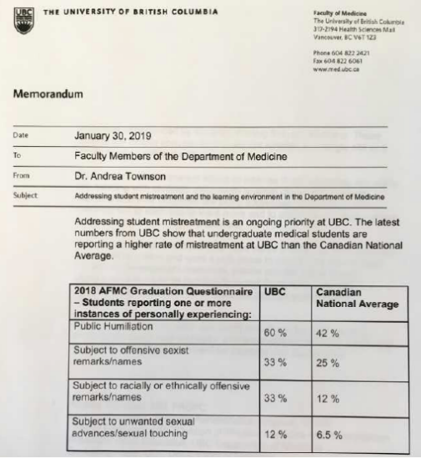

Vancouver Sun Feb. 20, 2019

Slide 76
Case Discussion
As the senior resident in an intensive care unit (ICU), I had just finished a particularly difficult discussion with a patient's family. My patient was an elderly man with advanced dementia and a weak heart who had collapsed at home. Now that he was ventilator-dependent and showing no signs of meaningful neurologic function, his wife asked that he not undergo cardiac resuscitation if his heart were to stop beating.
The family left the ICU, and I sat down to document our conversation and place a do-not-resuscitate (DNR) order in his chart, a task that, at our hospital, can be performed only by senior trainees or attending physicians. The telephone in the unit rang. “The patient's wife wants to talk with his doctor,” the unit clerk called. Confused, I picked up the phone.
“I need to talk to Dr. W.,” she said, asking for my intern, who had met the patient's family only briefly earlier in the day. “He's on another call. Is there something I can help you with?” I asked.
“No, I need to speak with the doctor directly,” she repeated. I paused for a moment, considering whether it was worth clarifying that I was a physician (and one with more seniority), but decided that this woman's day had been challenging enough. I waited for Dr. W. to finish his other call and silently handed over the phone. I listened to the patient's wife repeat our conversation and ask Dr. W. to document that her husband should not undergo resuscitation. Then, I waited for his response — for him to clarify that he was the most junior physician on the team and placing a DNR order was not a task he was able to perform or that I was his senior resident and had already placed the order honoring her and her husband's wishes.
He did neither.
(Rabinowitz, 2018)
Notes:
Rabinowitz LG. The New England Journal of Medicine. 2018; 378 (24): 2253-2255. doi: 10.1056/NEJMp1802228.

Slide 77
Discussion
If you were the senior resident, what would you do?
How would you feel?
What could be changed in the system to prevent this?

Slide 78
Gender based Role Misidentification:
Women physicians more likely to be misidentified as non-physicians:
100% of women vs 44% of women
  Almost daily occurrence for women
Has potentially important ramifications.
    Decisions often questioned by patients
    Decisions questioned by nursing
    Negatively affects relationships
    Negatively affects satisfaction with job
    Anger and Annoyance
(Berwick, et al., 2021)
Notes:
Purpose:
Evaluation of the medical profession at all levels has exposed episodes of gender-based role misidentification whereby women physicians are disproportionately misidentified as non-physicians. The authors of this study investigate this phenomenon and its repercussions, quantifying the frequency with which resident physicians experience role misidentification and the effect this has on their experience and behavior.
What they found was All 85 of the women respondents (100%) reported being misidentified as non-physicians at least once in their professional experience by patients or staff members, compared to 49% of the 97 men respondents. Of those 182 residents, 35% of women were misidentified more than 8 times per month by patients compared to 1% of men. Of the 85 women physicians responding to the survey, 38% felt angry and 36% felt less satisfied with their jobs as a result of misidentification compared to, respectively, 7% and 9% of men. In response to role misidentification, 51% of women changed their manner of attire and 81% changed their manner of introduction, compared to 7% and 37% of men.
Conclusions:
These survey results demonstrate that women physicians are more likely than men physicians to be misidentified as non-physicians and that role misidentification provokes gender-polarized psychological and behavioral responses that have potentially important professional ramifications.

Slide 79
Awareness is the first step
Action is the next

Slide 80
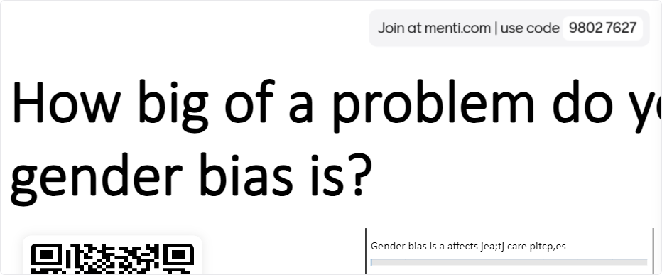
How big of a problem?

Slide 81

What questions do you still have?

Slide 82
Equity Matters!
Women face bias when receiving health care
Women physicians face bias in their career
When we know better – do better.
  Address knowledge mediated gaps
  Include women in research trials
  Address implicit bias
  Take Action!
Notes:
Women face challenges when receiving health care
Gender bias in delivery
Undersupply of women’s health specialists
Gaps in medical research
Politicization of women’s health
Women physicians also face challenges
Career options
Leadership opportunities
Pay inequity
When we know better – do better.
Address knowledge mediated gaps
Include women in research trials
Address implicit bias

Slide 83
Thank You

Slide 84
References
Adesoye T, Mangurian C, Choo EK, Girgis C, Sabry-Elnaggar H, Linos E. Perceived Discrimination Experienced by Physician Mothers and Desired Workplace Changes. JAMA Intern Med. 2017;31(9):1004–1010. doi: 10.1001/jamainternmed.2017.1394.
Alcalde-Rubio L, Hernández-Aguado I, Parker LA, Bueno-Vergara E, Chilet-Rosell E. Gender disparities in clinical practice: are there any solutions? Scoping review of interventions to overcome or reduce gender bias in clinical practice. Int J Equity Health. 2020 Sep 22;19(1):166. doi: 10.1186/s12939-020-01283-4. PMID: 32962719; PMCID: PMC7510055.
Balch, B., (March 26, 2024), Why we know so little about women’s health. AAMC News. Retrieved from www.aamc.org/news/why-we-know-so-little-about-women-s-health#:~:text=Women%20were%20already%20poorly%20represented,2%20clinical%20trials%20unless%20they
Banaji, M. R., & Greenwald, A. G. (2013). Blindspot: Hidden biases of good people. New York: Random House Publishing Group.
Barceló, N. E., & Shadravan, S. (2021). Race, metaphor, and myth in academic medicine. Academic Psychiatry, 45(1), 100-105.
Bever, 2024. From Heart disease to IUDs” How doctors dismiss women’s pain. https://www.washingtonpost.com/wellness/interactive/2022/women-pain-gender-bias-doctors/
Bates C, Gordon L, Travis E, et al. Striving for gender equity in academic medicine careers: a call to action. Acad Med 2016;91:1050-2.
Bondok, M., Bondok, M. S., Nguyen, A. X. L., Law, C., Nathoo, N., Bakshi, N., ... & Damji, K. F. (2024). Gender trends in match rate to surgical specialties in Canada: A retrospective study from 2003–2022. Plos one, 19(4), e0300207.
Borkhoff CM, Hawker GA, Kreder HJ, Glazier RH, Mahomed NN, Wright JG. The effect of patients' sex on physicians' recommendations for total knee arthroplasty. CMAJ. 2008 Mar 11;178(6):681-7. doi: 10.1503/cmaj.071168. PMID: 18332383; PMCID: PMC2263116.
Brännström J, Hamberg K, Molander L, Lövheim H, Gustafson Y. Gender disparities in the pharmacological treatment of cardiovascular disease and diabetes mellitus in the very old: an epidemiological, cross-sectional survey. Drugs Aging. 2011;28(12):993-1005.
Canadian Medical Association. (2018). Addressing gender equity and diversity in Canada’s medical profession: a review. Canadian Medical Association & Federation of Medical Women of Canada; 2018:16. https:// www. cma.ca/ sites/ default/files/pdf/Ethics/report-2018-equity-diversity-medicine-e. pdf.
Carr PL, Ash AS, Friedman RH, et al. Faculty Perceptions of Gender Discrimination and Sexual Harassment in Academic Medicine. Ann Intern Med. 2000;132(11):889. doi: 10.7326/0003-4819-132-11-200006060-00007.

Slide 85
References
Cohen M, Kiran T. Closing the gender pay gap in Canadian medicine. CMAJ. 2020;192(35):E1011-E1017. doi:10.1503/cmaj.200375
Kimberlé Williams Crenshaw:
Enriquez JR, Pratap P, Zbilut JP, Calvin JE, Volgman AS. Women tolerate drug therapy for coronary artery disease as well as men do, but are treated less frequently with aspirin, beta-blockers, or statins. Gend Med. 2008; 5(1):53–61.
Evans, 2007, 131 (find)
Files JA, Mayer AP, Ko MG, Friedrich P, Jenkins M, Bryan MJ, Vegunta S, Wittich CM, Lyle MA, Melikian R, Duston T, Chang YH, Hayes SN. Speaker Introductions at Internal Medicine Grand Rounds: Forms of Address Reveal Gender Bias. J Womens Health (Larchmt). 2017 May;26(5):413-419. doi: 10.1089/jwh.2016.6044. Epub 2017 Feb 16. PMID: 28437214.
FitzGerald C, Hurst S. Implicit bias in healthcare professionals: a systematic review. BMC Med Ethics. 2017 Mar 1;18(1):19. doi: 10.1186/s12910-017-0179-8. PMID: 28249596; PMCID: PMC5333436.
Goldstein, R. H. & Walensky, R. P. (2019). Where Were the Women? Gender Parity in Clinical Trials The New England Journal of Medicine, 381 (26), 2491-2493. doi: 10.1056/NEJMp1913547.
Glauser W. Physician billing data reveal striking gender pay gap. CMAJ. 2020 Sep 8;192(36):E1051-E1052. doi: 10.1503/cmaj.1095894. PMID: 32900771; PMCID: PMC7504888.
Kavurma, M. M., Boccanfuso, L., Cutmore, C., Passam, F., Patel, S., Hennessy, A., ... & Aitken, S. (2023). A hidden problem: peripheral artery disease in women. European Heart Journal-Quality of Care and Clinical Outcomes, 9(4), 342-350.
Lat, T. I., McGraw, M. K., & White, H. D. (2021). Gender differences in critical illness and critical care research. Clinics in chest medicine, 42(3), 543-555.
Lorello GR, Silver JK, Moineau G, McCarthy K, Flexman AM. Trends in Representation of Female Applicants and Matriculants in Canadian Residency Programs Across Specialties, 1995 to 2019. JAMA Netw Open. 2020;3(11):e2027938. doi:10.1001/jamanetworkopen.2020.27938
Lyratzopoulos G, Abel GA, McPhail S, Neal RD, Rubin GP. Gender inequalities in the promptness of diagnosis of bladder and renal cancer after symptomatic presentation: evidence from secondary analysis of an English primary care audit survey. BMJ Open. 2013;3:e002861
David M Markowitz, Gender and ethnicity bias in medicine: a text analysis of 1.8 million critical care records, PNAS Nexus, Volume 1, Issue 4, September 2022, pgac157, https://doi.org/10.1093/pnasnexus/pgac157
Mehta LS, Beckie TM, DeVon HA, et al, for the American Heart Association Cardiovascular Disease in Women and Special Populations Committee of the Council on Clinical Cardiology, Council on Epidemiology and Prevention, Council on Cardiovascular and Stroke Nursing, and Council on Quality of Care and Outcomes Research. Acute myocardial infarction in women: a scientific statement from the American Heart Association. Circulation. 2016;133:916-947.

Slide 86
References
Miller M, Byington R, Hunninghake D, Pitt B, Furberg CD. Sex bias and underutilization of lipid-lowering therapy in patients with coronary artery disease at academic medical centers in the United States and Canada. Prospective Randomized Evaluation of the Vascular Effects of Norvasc Trial (PREVENT) Investigators. Arch Intern Med. 2000;160(3): 343–347.
Poisson SN, Johnston SC, Sidney S, Klingman JG, Nguyen-Huynh MN. Gender differences in treatment of severe carotid stenosis after transient ischemic attack. Stroke. 2010;41(9):1891–1895.
Pope, J. H., Aufderheide, T. P., Ruthazer, R., Woolard, R. H., Feldman, J. A., Beshansky, J. R., ... & Selker, H. P. (2000). Missed diagnoses of acute cardiac ischemia in the emergency department. New England Journal of Medicine, 342(16), 1163-1170
Ruzycki, S. M., Earp, M., & Ma, I. W. (2020). Applicant gender and matching to first-choice discipline: a cross-sectional analysis of data from the Canadian Resident Matching Service (2013–2019). Canadian Medical Association Open Access Journal, 8(2), E346-E351.
Anke Samulowitz, Ida Gremyr, Erik Eriksson, Gunnel Hensing, "“Brave Men” and “Emotional Women”: A Theory-Guided Literature Review on Gender Bias in Health Care and Gendered Norms towards Patients with Chronic Pain", Pain Research and Management, vol. 2018, Article ID 6358624, 14 pages, 2018. https://doi.org/10.1155/2018/6358624
Salles, A. , Awad, M. , Goldin, L. , Krus, K. , Lee, J. V. , Schwabe, M. T. & Lai, C. K. (2019). Estimating Implicit and Explicit Gender Bias Among Health Care Professionals and Surgeons. JAMA Network Open, 2 (7), e196545. doi: 10.1001/jamanetworkopen.2019.6545
Steffler M, Chami N, Hill S, Beck G, Cooper SC, Dinniwell R, Newbery S, Simkin S, Chang-Kit B, Wright JG, Kantarevic J, Weir S. Disparities in Physician Compensation by Gender in Ontario, Canada. JAMA Network Open 2021;4(9):e2126107. doi:10.1001/jamanetworkopen.2021.26107
Templeton, K., Nilsen, K. M., & Walling, A. (2020). Issues faced by senior women physicians: a national survey. Journal of women's health, 29(7), 980-988.
Tricco, A. C., Bourgeault, I., Moore, A., Grunfeld, E., Peer, N., & Straus, S. E. (2021). Advancing gender equity in medicine. Cmaj, 193(7), E244-E250.
Trix, F., & Psenka, C. (2003). Exploring the color of glass: Letters of recommendation for female and male medical faculty. Discourse & Society, 14(2), 191-220

Slide 87
References
UNDP (United Nations Development Programme). 2020. 2020 Gender Social Norms Index (GSNI): Tackling Social Norms: A game changer for gender inequalities. New York.
Vincent, J.-L., Juffermans, N. P., Burns, K. E. A., Ranieri, V. M., Pourzitaki, C., & Rubulotta, F. (2021). Addressing gender imbalance in intensive care. Critical Care, 25(1), NA. http://dx.doi.org.uml.idm.oclc.org/10.1186/s13054-021-03569-7
Vouyouka AG, Egorova NN, Salloum A, et al. Lessons learned from the analysis of gender effect on risk factors and procedural outcomes of lower extremity arterial disease. J Vasc Surg. 2010;52(5):1196–1202
Westergaard D, Moseley P, Sørup F, Baldi P, Brunak S. Population-wide analysis of differences in disease progression patterns in men and women. Nat Commun. 2019;10:666
Yu PT, Parsa PV, Hassanein O, et al.. Minorities struggle to advance in academic medicine: a 12-y review of diversity at the highest levels of America’s teaching institutions. J Surg Res 2013;182:212–8.
Zhang, L., Losin, E. A. R., Ashar, Y. K., Koban, L., & Wager, T. D. (2021). Gender biases in estimation of others’ pain. The journal of pain, 22(9), 1048-1059.
Zephyrin, L., Suennen, L., Viswanathan, P., Augenstein, J., & Bachrach, D. (2022). Part 1: A framework for addressing gaps and barriers."Gender bias in health care may be harming women." UWIRE Text, 2Feb. 2016, p. 1. Gale OneFile: Health and Medicine, link.gale.com/apps/doc/A442909125/HRCA?u=univmanitoba&sid=bookmark-HRCA&xid=d6a3d377. Accessed 6 May 2024.

