Slide 1
MED2 WELLNESS FAIR FINANCIAL HEALTH
APRIL 27, 2022
Wendy L. Schultz, PhD, CPA, CA

Slide 2
AGENDA
Economic Update: Borrowing
Economic Update: Investing
Income Tax
Goals & Goal Planning
FOMO

Slide 3
ECONOMIC UPDATE - BORROWING
The Bank of Canada prime lending rate is currently 3.2%.
Student LOC interest rate 2.95% (prime – 0.25%)
Bank of Canada started increasing its benchmark interest rate on March 2, 2022. At its last meeting, the Bank increased the prime lending rate by 0.5%, which was the largest individual rate hike since 2000.
The Bank had previously said that it had no plans to change its benchmark interest rate until inflation gets back to 2% and stays there.
However, current inflation rates (e.g., March 2022 - 5.7%) are artificially high due to pandemic-related disruptions and geopolitical risks.
Increasing interest rates decreases inflation.
Economists expect multiple rate increases in 2022, including another possible 0.5% increase at the Bank’s next announcement date of June 1, 2022.

Slide 4
IMPACT OF BANK OF CANADA RATE INCREASES
These rate increases will increase the interest rate on your student LOC.
The total cost of borrowing on your LOC will be higher, as interest rates rise.
Purchases you make today at 2.95% interest (and higher, as rates increase throughout 2022) will need to be repaid in the future at a higher rate of interest.
Use your LOC prudently.
Consider needs vs. wants when making decisions to use your LOC funds.
Start to repay your LOC during residency, if cash flow permits.
Student loan projection calculator

Slide 5
ECONOMIC UPDATE - INVESTING
U.S. stock markets ended 2021 at near record highs.
S&P 500 2021 annual return was 26.89%!
This may make you wonder if you should be investing in the stock market.
However, remember the -30.75% drop in March 2020, when the stock market reacted to expected future impacts of the Covid-19 pandemic.
S&P 500 2020 graph

Slide 6
SHOULD I INVEST IN THE STOCK MARKET?
When making investment decisions, your investment horizon is the most important consideration.
Your investment horizon refers to how long you expect your money to remain invested before you cash it in.
What are you saving money for?
Tuition
Car purchase
Vacation/wedding/house down payment
Your investment horizon for these types of savings is short (<5 years); these funds should NOT be invested in the stock market.

Slide 7
INCOME TAX
No income? Still file a tax return. Why?
GST Credit – up to $456 (if single)
Tuition and Education Amounts – can carry forward to future years to reduce taxes payable
Education Property Tax Credit – claim 20% of rent, max $525
Climate Action Incentive - $416/adult; paid quarterly in 2022
File your return online for free with Ufile. Deadline to file is May 2, 2022

Slide 8
GOALS & GOAL PLANNING
Life’s biggest events happen in a narrow range of time:
Career
Marriage
House
Children
Big 4 goals:
Home
Children
Retirement
Student debt repayment

Slide 9
GOALS & GOAL PLANNING
3 components of goal planning:
Goal
Timeline
Cost
1 of the Big 4 goals:
Student debt repayment
Set goals and measure progress
Adjust strategies as goals evolve
Repay $181,860 student debt
Within 10 years of residency
Need to repay $18,186/year

Slide 10
BEHAVIOURAL FINANCE

Slide 11
FINANCIAL FOMO
FOMO is the virtual equivalent of “Keeping up with the Joneses.”
Med Student FOMO:
Some students in my class are buying condos, should I?
Some of my friends decided to invest in the stock market, so I did, too.
I used my LOC to buy my “doctor” car.
Many, if not most, FOMO-triggered expenses are unplanned and over time, can add up to a lot of money.
Does having what others have really make us happy? NO!
Think instead about KEEPING UP WITH YOUR OWN GOALS!

Slide 12
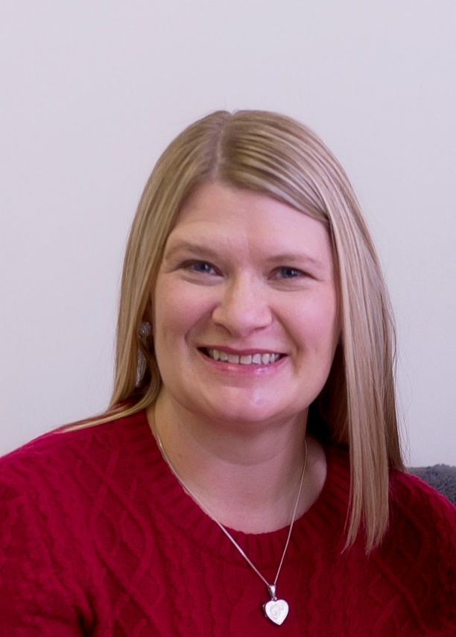
A PERSONAL NOTE FROM ME
Dear Class of 2024,
I had hoped to be here with you today. But sometimes life has other plans... Know that I am well, all things considered, and think of you often.
I hope that you have learned from our previous sessions, and are making prudent financial decisions in my absence! To my “regulars,” I miss you and our periodic check ins. I hope that you and your classmates are supporting each other, and I look forward to reconnecting with you all in a few short months.
In the meantime, enjoy the summer (if it ever comes!).
My warmest regards,
Wendy

Slide 13
WANT TO LEARN MORE?
wendyschultzlifelessons.ca
Read more about these and other financial literacy topics on my blog.

Slide 14
CONTACT (UNTIL AUGUST 2022)
studentaffairsmed@umanitoba.ca

