Slide 1
Professionalism and Speak Up
Office of Professionalism, Max Rady College of Medicine
Dr. Eric Jacobsohn, Associate Dean
Dr. Nancy Porhownik, Assistant Dean
Anitra Squires, Confidential Intake Coordinator
Vanessa Sunico, Office Assistant

Slide 2
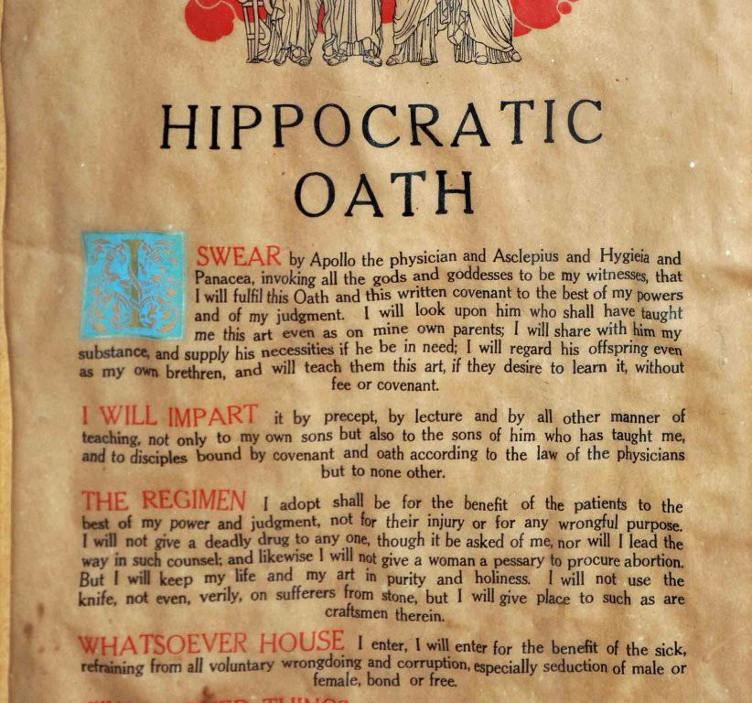
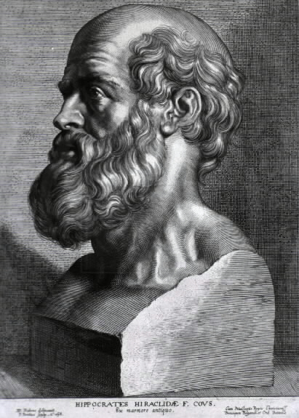
Hippocrates, 460-370 BCE
….I swear by Apollo Healer, by Asclepius, by Hygiea, by Panacea ......
Notes:
It is apt that we start a discussion about professionalism with The Hippocratic Oath, the cornerstone of professionalism in Western Medicine.
The original language has some problematic phraseology by todays standards, but of course reflected the norm of the times. The opening statements of the Oath is germane to todays talk and it states “ that I swear by Apollo Healer, Asclepius, by Hygiea….to hold my teachers in this art equal to my parents’.
You did recite a modified professionalism code on Wednesday at the White Coat. How did that happen?

Slide 3
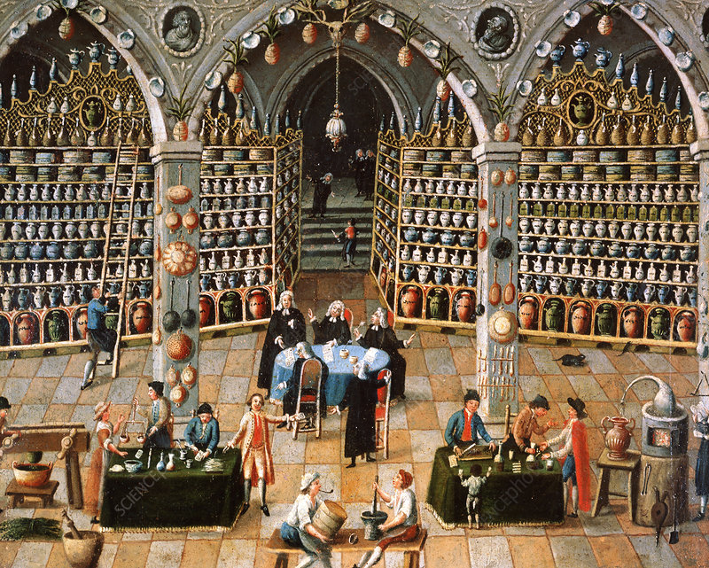
Medicine & professionalism until the 18th century
“Colorful” few centuries in medicine
Many theories of disease, many “healers”
Allopaths, homeopaths, naturopaths, botanists, female midwives , man-midwives, surgeons, apothecaries, veterinarians, and many quacks
It was unregulated and chaotic
$ often was often the motive
There was a profound public distrust for healers
Anonymous Artist. Reception room of a “master” apothecary. University Paris Descartes
McCullough L et al. Academic Medicine 2020
Notes:
However, our Profession’s development over the ensuing centuries was colorful, many theories of disease came and went, many called themselves healers, included allopaths, homeopaths, naturopaths, botanists, female midwives, man midwives, surgeons, apothecaries, vets and many quacks.
It was unregulated, money was often the motive, it was chaotic, and distrust for healers developed.
You get a flavor for this chaos in this mid 1800s painting of the reception room of what was a master apothecary.

Slide 4
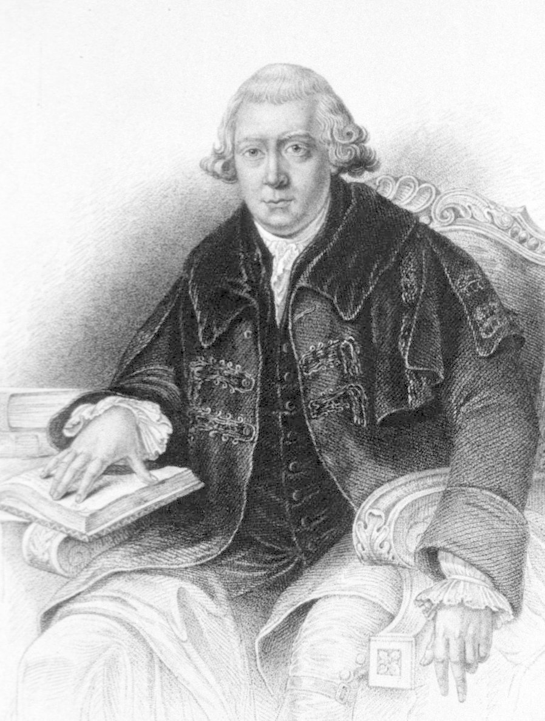
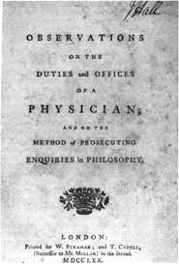
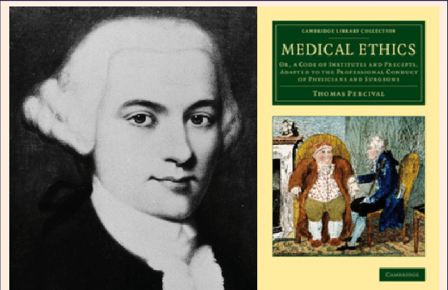
Ethical & professional movements as antidotes to the distrust of healers
John Gregory (1724–1773)
Aberdeen, Edinburgh
Thomas Percival (1740–1804)
Manchester
1770
1803
Notes:
Modern medicine’s professional evolution evolved as an antidote to the chaos. Two doctors are recognized as the change agents: John Gregory (1724–1773) of Aberdeen, Scotland and Thomas Percival (1740–1804) of Manchester England.
Both, through seminal publications in 1770 and 1803 respectively, established a narrative around the ethical concept of medicine as a profession, including the way physicians should conduct themselves.

Slide 5
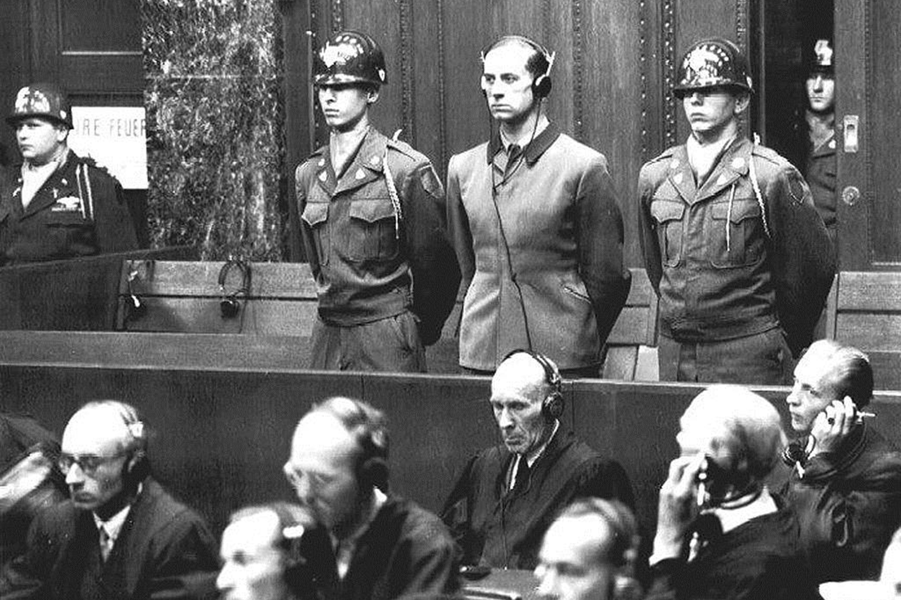
Organized medicine’s silence during WW2
Nuremberg
Doctors Trial1946
Gregory/Percival’s concepts were never codified
Unspeakable crimes by doctors
Organized medicine had largely been silent
Nuremberg Doctors Trial 1946
World Medical Association was formed in 1946
1. To develop a modern code of professional conduct
2. Establish an international ethical and professional framework for doctors
Notes:
Although the writings of Gregory and Percival were meant to be transformative to the profession, this was never really codified. There was limited international interaction between professional and ethics bodies, and the APIM, which existed between 1926 and 1939, was a small group of by-invitation-only medical associations that met to discuss professionalism and ethical matters. It dissolved at the onset of WW2.
WWI tragically witnessed terrible crimes against humanity, including horrific crimes perpetrated by physicians. These were exposed during the Nuremberg doctors trials in 1946. Evil in the medical profession had unfortunately also been accompanied by a failure of much of organized medicine to Speak Up and a failure to take advocacy position. There were of course some notable exceptions.
In 1946, the remnants of what had been APIM regrouped, and with a much broader participation, and World Medical Association was formed. The primary goal was to codify professionalism and medical ethics in an international framework.

Slide 6
Modern Code of Professional Conduct (aka Declaration of Geneva); 2nd General Assembly of the WMA, 1948
The Physician’s Pledge (the “modern” Hippocratic Oath)
Declaration of a doctor’s dedication to the humanitarian goals of medicine
Uses modern language, has relevant language, and is “updated” as required
It is the Oath that you recited on Wednesday
AS A MEMBER OF THE MEDICAL PROFESSION I SOLEMNLY PLEDGE:
TO DEDICATE my life to the service of humanity;
THE HEALTH AND WELL-BEING OF MY PATIENT will be my first consideration;
I WILL RESPECT the autonomy and dignity of my patient;
I WILL MAINTAIN the utmost respect for human life;
I WILL NOT PERMIT considerations of age, disease or disability, creed, ethnic origin, gender, nationality, political affiliation, race, sexual orientation, social standing or any other factor to intervene between my duty and my patient;
I WILL RESPECT the secrets that are confided in me, even after the patient has died;
I WILL PRACTISE my profession with conscience and dignity and in accordance with good medical practice;
I WILL FOSTER the honor and noble traditions of the medical profession;
I WILL GIVE to my teachers, colleagues, and students the respect and gratitude that is their due;
I WILL SHARE my medical knowledge for the benefit of the patient and the advancement of healthcare;
I WILL ATTEND TO my own health, well-being, and abilities in order to provide care of the highest standard;
I WILL NOT USE my medical knowledge to violate human rights and civil liberties, even under threat;
I MAKE THESE PROMISES solemnly, freely, and upon my honor.
https://wma/.net International Code of Medical Ethics –The World Medical Association
Notes:
The WMA, through the Declaration of Geneva, created two codes that would become the cornerstone of international professional practice and conduct in medicine:
The modernized or revised Hippocratic Oath was adopted by the WMA 2nd general assembly in 1948, and used language that was understandable and was responsive to the atrocities that had occurred. In essence it is a declaration of a doctor’s dedication to the humanitarian goals of medicine.
The WMA Code of Medical Ethics, adopted at the 3rd general assembly in 1949, and is a broader framework of professional conduct, including the physicians duties to patients, to there colleagues, and general duties.

Slide 7
WMA Code of Medical Ethics; 3rd General Assembly of the WMA, 1949
Is the basis of international medical associations codes of professionalism
The Canadian Medical Association Code of Ethics
The College of Physicians and Surgeons of Manitoba Code of Ethics
A. Virtues B. Commitments C. Responsibilities
https://wma/.net International Code of Medical Ethics –The World Medical Association;
CMA Code of Medical Ethics, 2018; CPSM of Manitoba 2022
Notes:
The WMA, through the Declaration of Geneva, created two codes that would become the cornerstone of international professional practice and conduct in medicine:
The modernized or revised Hippocratic Oath was adopted by the WMA 2nd general assembly in 1948, and used language that was understandable and was responsive to the atrocities that had occurred. In essence it is a declaration of a doctor’s dedication to the humanitarian goals of medicine.
The WMA Code of Medical Ethics, adopted at the 3rd general assembly in 1949, and is a broader framework of professional conduct, including the physicians duties to patients, to there colleagues, and general duties.

Slide 8
The Office of Professionalism
Our mandate is to monitor and deal with matters related to Professionalism and the Learning Environment
To develop processes to improve the Learning Environment and Professionalism in the Max Rady College of Medicine
To deal with matters related to professionalism and learner mistreatment

Slide 9
Learner Mistreatment
Policy for the Prevention of Learner Mistreatment
Defines mistreatment as:
”An intentional, or unintentional, disrespectful treatment of a learner, trainee, or colleague that has or may have the effect of creating an intimidating, humiliating, hostile or offensive work or learning environment for Learners in that circumstance. It entails a behavior that shows disrespect for the dignity of others and can take the form of physical or psychological punishment, harassment or discrimination”
3 other Universities Policies relevant to reporting
Respectful Work and Learning Environment Policy
Disruption of All Forms of Racism Policy
Sexual Violence Policy

Slide 10
Examples of Mistreatment*
Verbal:
Embarrassing or humiliating actions
Abusing, belittling, ridiculing or yelling
Sarcasm, insults
Racially or ethnically offensive remarks or names
Disparaging choice of residency, profession, career aspirations
Threatening to fail/ ↓ grades/give poor evaluation for anything other than documented performance issues
Physical:
Threatening gestures
Physical abuse
Pushing, shoving, slapping
Sexual:
Sexual advances, favors, comments
Other:
Not providing clear work expectations yet holding responsible for the expectations
Excluding a Learner from reasonable learning opportunities or communications
Using grades or duties as punishment
*from Policy for Prevention of Learner Mistreatment, Max Rady College of Medicine

Slide 11
Pathways for Reporting Mistreatment
Program
PD
Ombudsperson
Clinical Department
Assoc Head Education
University
OHRCR
Dept Head
UGME/PGME
Student Support Services
Office of Professionalism
Speak Up
Evaluation – Mistreatment Report
Direct Referral
Teachers, preceptors, admin staff
Student Affairs

Slide 12
Speak Up “Button”
Confidentiality
When you make a CONFIDENTIAL report, the Confidential Intake Coordinator will contact you to set up a confidential meeting with the Speak Up Lead in your College.
This meeting allows for a discussion regarding your complaint, potential ways forward, outcome options, and any concerns that you may have regarding confidentiality.
Based on this confidential discussion, you will then confirm whether or not you wish to pursue your concern, resubmit it as an ANONYMOUS report, or even withdraw it.
While we do accept ANONYMOUS reports, the ability to respond may be limited and we will be unable to provide you with feedback regarding actions taken.

Slide 13
What Happens When I Make a Speak Up Report?
Received by Confidential Intake Coordinator
Review with Associate and Assistant Deans, Office of Professionalism
If contact information is provided, email confirming receipt & offer of a meeting is sent
Intake meetings are student centered
Explore expectations i.e. What is the reporter hoping to achieve?
Explore coping, supports, need for additional resources
Gain further details, clarification of their concerns
Discuss next steps (e.g. forwarding concerns to appropriate leadership, meeting with the respondent, retracting complaint, etc.)
Follow up with reporter once their concerns have been addressed – details are not provided
Downside of anonymous reports is that none of these goals can be achieved with reporters

Slide 14
What if I’m not sure about making a report?
Reach out!
professionalism@umanitoba,ca
ejacobsohn@hsc.mb.ca
Nancy.Porhownik@umanitoba.ca
Cortext
Phone 204-789-3207
We would be happy to help you find the best place to address your concerns!
It is always confidential

Slide 15
Questions & Discussion

Slide 16
Thank you Good luck

