Slide 1
UGME Student Affairs
We’re Here for You- Now and Until Graduation!

Slide 2
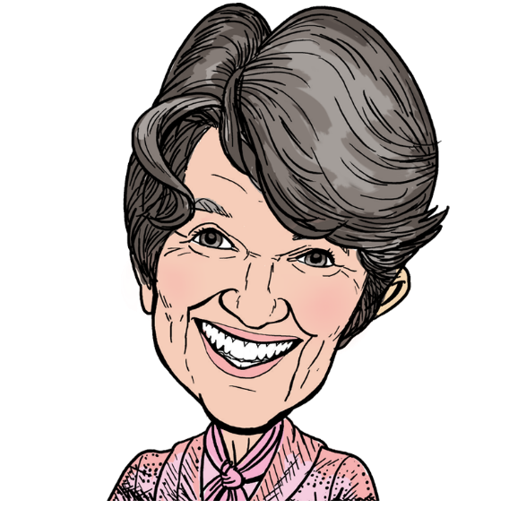
Dr. Aviva Goldberg
Associate Dean, UGME Student Affairs
Dr. Sally Longstaffe
Senior Academic Advisor

Slide 3
No Wrong Door

Slide 4
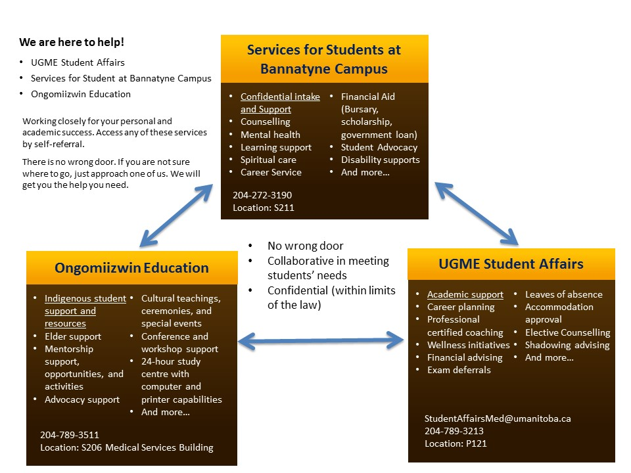

Slide 5
Facts about NBME exams
6 single subject exams, all summative/tend to be long exams
Previously- failure rate on a single NBME exam is 18-20%; failure or two or more NBME exams is about 5%
Change to pass mark has significantly lowered failure rate

Slide 6
Facts about NBME Exams
Different type of exam with large volume of tested material
What is needed to pass is different from that needed on wards
Time management in preparation for exam and during exam is needed
Passing is non-negotiable

Slide 7
Rules about NBME exams
One failure does not appear on MSPR (appears as “pending” until passed)
Failure of supplemental NBME exam=need for remedial clinical rotation and appears on MSPR
Failure of 5 different NBME exams or 3 of same NBME=repeat clerkship

Slide 8
We believe in prevention
This is hard!
Your are not alone!
Get help early if having difficulty (exam anxiety/evaluating study strategy/stress/physical or mental health/financial problems/managing extracurricular commitments, managing study, work and sleep)
No problem is too small or too big

Slide 9
Some policy points to remember
UGME Attendance Policy: (little tolerance for absences), missing 25% of rotation for any reason means failure of rotation- does not mean that you only need to show up for 75% of the rotation!
NBME Examination deferral: See us for help in navigating this in case of emergency or illness (form/documentation to submit-5 days notice unless emergency)

Slide 10
Policy Points to Remember
Must complete deferred exams before supplemental exams
See Student Accessibility Services if need exam accommodation
Leave of Absence policy: See us for discussion and help/case by case consideration before approval (injury/illness/maternity leave/crisis/academic leave)

Slide 11
COVID-19 exposure
Follow OESH guidelines
Do not come to work or an exam with symptoms, even if mild
Can write NBME exam from home with mild symptoms if you need to (need 72 hours notice) or defer
Extended absence may result in incomplete, but we will work with you to minimize effect on electives time

Slide 12
Vaccine mandates
U of M- as of Sept 14- fully vaccinated or frequent testing
Shared Health- as of October 31- fully vaccinated or frequent testing

Slide 13
Common reasons for SA Support During Clerkship
Electives advice
Exam failures
Deferrals and LOAs
Existential crises (I don’t know what I want to be)
Personal letter advice, dealing with tricky interview issues
ROL, couples matching
Burnout
Personal life and impact on school

Slide 14
Finances in Clerkship
A car
Electives application fees and tour **
CaRMS application fees and tour **
Exams
Moving expenses
Lifestyle inflation
Retail therapy
Being kind to yourself

Slide 15
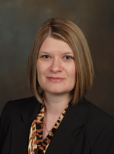
Important Financial Take Homes
This year is expensive
Spend money, but spend it wisely
Do not scrimp on yourself
Don’t fake it till you make it
Ask for help if you need it

Slide 16
Support available
Leah Deane

Slide 17
NBME Study Tips
Dr. Phoebe Thiessen
They’ll be back in January!!

Slide 18
Student Panels

