Slide 1
Transition to Clerkship: Managing stress in a stressful environment
Leah Deane (she/her), MSW RSW
Director - Student Services at Bannatyne Campus
Notes:
Recognize that the environment that you are working in is inherently stressful. You may not be able to control that, but you can develop skills and strategies to help you manage and function better in these environments.

Slide 2
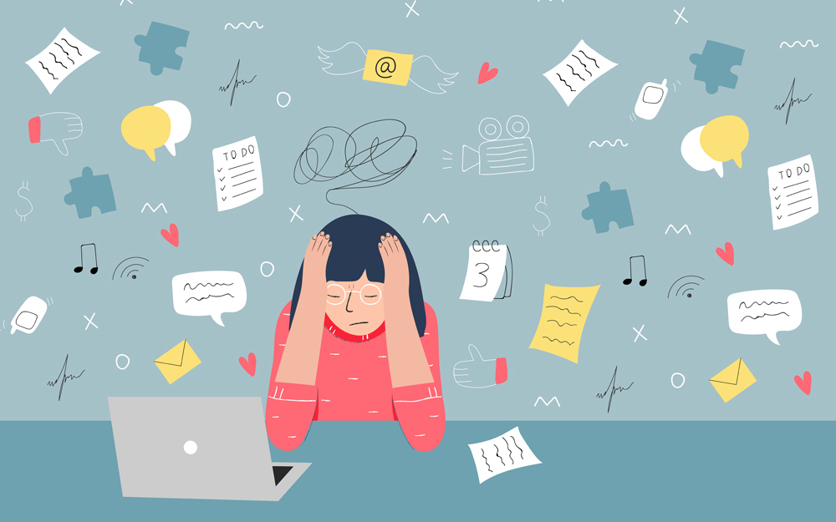
Overview
Stress, stress-management, stress outcomes
Coping strategies
Maintaining a healthy balance
Information on supports and resources
Notes:
I’m going to speak with you about stress; what it is, how to manage it, and what can happen if we don’t.
We can’t always prevent or control what is going to cause us to be stressed, but we can look at how to develop some helpful coping strategies and ways to maintain a healthy balance.
There will be opportunities for you to develop these strategies individually, but there may also be times when you might need some additional external supports and resources and I will share some information on what we may have to offer to help you in this next stage of your program

Slide 3
Stress Defined
“Stress is any uncomfortable emotional experience accompanied by predictable biochemical, physiological and behavioral changes” (American Psychological Association)
Stress is part of everyday life, and all adults feel stress at times. Stress is problematic when it disrupts someone’s life
Stress can gradually build if not managed well and can lead to serious difficulties like anxiety and depression
But…..some stress can be helpful.

Slide 4
Some Stress Can Be Helpful
The Yerkes-Dodson Curve
Notes:
We can see from this model that some stress can be helpful, but only to a point. As our sympathetic nervous system activates, it increases our heart rate, metabolism, breathing, muscle tension and blood pressure. This can improve our focus and attention. It can help us to concentrate and get things done and can motivate us to do better.
However, when levels of arousal become too high, performance decreases and can result in anxiety, panic, and burn out.

Slide 5
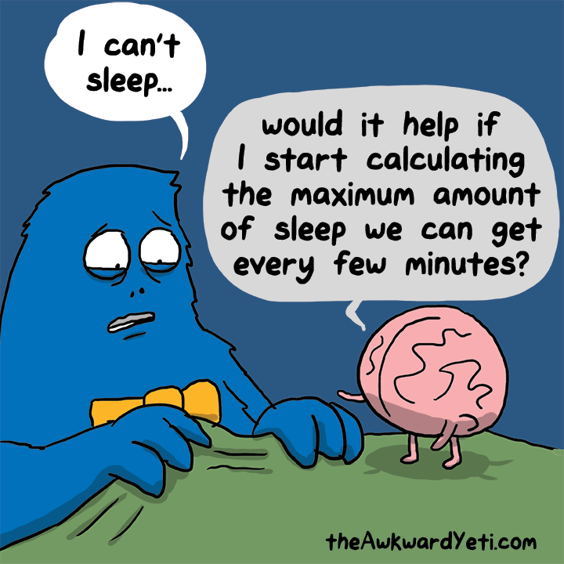
Too Much Stress can Impact:
Mental Health
Ability to Cope
Compassion Fatigue
Anxiety
Depression
Low self-esteem
Burnout
Loss of Appetite
Lack of Sleep

Slide 6
What is Burnout?
Burnout is a state of emotional, physical, and mental exhaustion caused by excessive and prolonged stress. It occurs when you feel overwhelmed, emotionally drained, and unable to meet constant demands
Notes:
As the stress continues, you begin to lose the interest and motivation that led you to take on a certain role in the first place.

Slide 7
Early Signs of Burnout in University Students
Loss of Motivation
Continual Lack of Energy
Boredom
Inability to Concentrate
Lower Academic Achievement
Detachment
Lowered Immunity to Illnesses or Diseases

Slide 8
Types of Stress
Personal
Assessment (performance anxiety)
Insecurity about clinical competency (imposter syndrome)
Time Management
Workload
Expectations
Grades
Interpersonal
Miscommunication
Conflict with peers
Conflict with professors/educators
Notes:
There are different types of stress that can impact you.
As you are moving into Clerkship, the expectations on you are changing. With this, can come an increase in stress around performance anxiety, imposter syndrome, managing your time and workload.
But it can also be a new source of interpersonal stress.

Slide 9
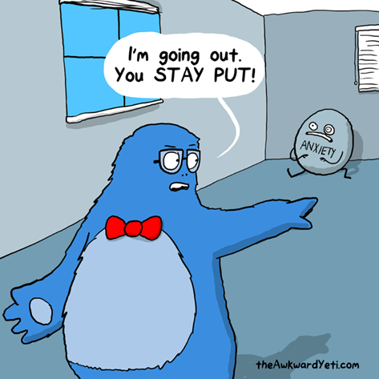
Interpersonal
“stressful episodes between two or more people”
Reasons for interpersonal stress:
lack of feedback
lack of support or guidance
differing expectations
miscommunication
Notes:
Interpersonal stress in clerkship

Slide 10
Why do we need to address stress early?
When handled early…
Feel energized and motivated
Can feel innovative and have new ideas
Feel more committed to your role
Improve morale and performance
Improve relationships

Slide 11
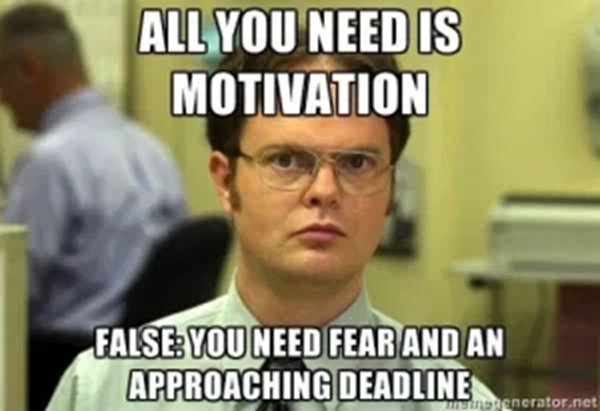
Why do we need to address Stress early?
When handled in a delayed manner…
Lower your performance
Increase stress and chance of becoming unwell
Reduce your efficiency and may increase absenteeism
Low morale or anger
Poor relationships
burnout

Slide 12
How stress affects us:
What are the symptoms?
Cognitively
Emotionally
Physically
Behaviorally
Notes:
Cognitive symptoms: memory problems, inability to concentrate or difficulty concentrating, poor judgement, seeing only the negative side of things, anxious, racing, or repeating thoughts, constant worrying, trouble learning new information, forgetfulness, difficulty making decisions
Emotional symptoms: moodiness, irritability or short temper, overreaction to petty annoyances, defensive or suspicious, agitated or inability to relax, feeling overwhelmed, sense of loneliness or isolation, depression or general unhappiness, sudden attacks of panic
Physical symptoms: aches and pains, muscle tension, headaches, jaw clenching, or pain, diarrhea or constipation, nausea, dizziness, or butterflies in the stomach, chest pain or rapid heartbeat, loss of sex drive, fatigue or constant tiredness, difficulty breathing, frequent colds, shallow breathing and sweating, tremors or trembling of lips or hands, light-headedness, dry mouth or problems swallowing, rashes, itching, or hives
Behavioral symptoms: eating more or less, sleeping too much or too little, gritting or grinding teeth, isolation from others, procrastinating or neglecting responsibilities, using alcohol, tobacco, or drugs to relax, nervous habits (nail biting, pacing, feet tapping, fidgeting), excessive gambling or impulse buying

Slide 13
How to Prevent Burnout
Seek out social support
Engage in activities outside of your program
Change how you look at your workload/prioritize
Learn to manage stress well with healthy behaviours
Be kind to yourself!! Dr. Kristen Neff – Self-compassion
https://self-compassion.org
Notes:
We are all social beings. When we are feeling low energy and low self-esteem, we can tend to withdraw and become more recluse. It is important to work toward engaging with others and connecting with people we feel safe and comfortable with and who bring joy to our lives
Don’t add more to your plate but diversify how you spend your time
Remember the activities that you once found joy in. Perhaps it's playing a certain sport, listening to music, engaging in hobbies you enjoy like cooking, hiking, camping, etc. A couple of hours spent doing something you enjoy can feel like a hard reset for our system and can actually energize you to keep going with your work and studies.
Maintaining and engaging in healthy behavioural pattens can make a huge difference in preventing stress and burnout.
this can mean, getting to bed early, keeping a consistent routine, as much as possible
eating healthy and nutritious foods
moving your body and staying active
limiting how much time you spend reading negative news or scrolling social media
Lastly, being kind to yourself is SO important. We are often far more understanding and forgiving of others than we are of ourselves. It can be easy to beat yourself up or be critical. I challenge you to be your own friend. Engage in kindness and self-compassion – Kristen Neff has some amazing tools and information on self-compassion if you are interested in exploring this further

Slide 14
Steps to Manage Your Stressful Thinking
Normalize the stress you are feeling
Identify negative thoughts
Challenge these thoughts
Is the thought realistic?
What is the evidence that the thought is true? What is the evidence that the thought is false?
What would I tell a friend if they were feeling this way?
Notes:
You are beginning clerkship, in a highly demanding program. Many of you are very high achievers and are likely feeling the pressure to perform. All of this is normal. However, when you begin to doubt your ability and let your fears, anxieties, and nerves take over, it may result in some unhelpful thinking patterns.
It is important to take a pause and try to unpack some of these thoughts.

Slide 15
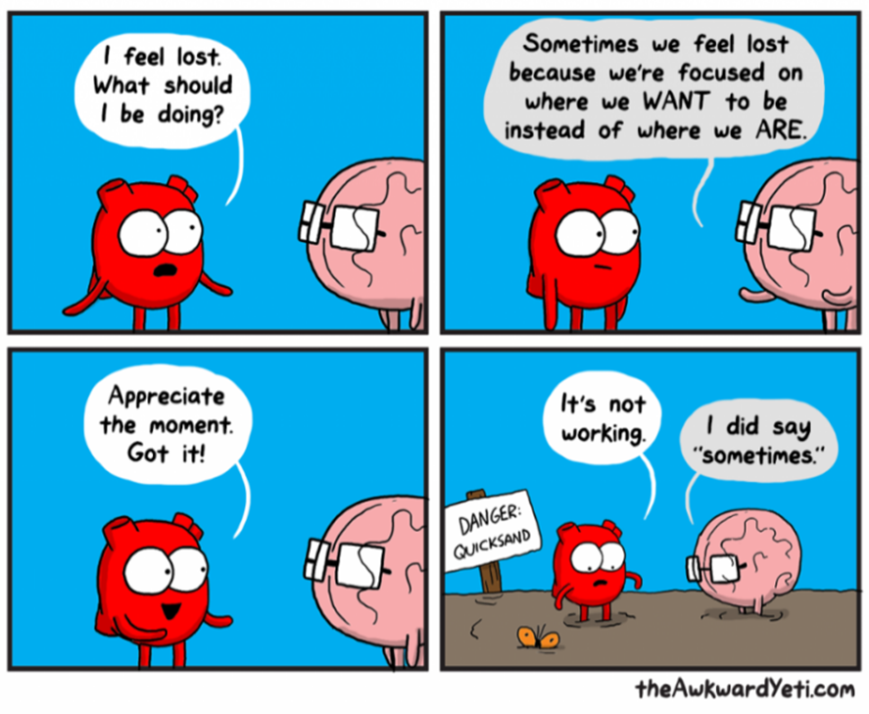
Mindfulness
Paying attention in a particular way; on purpose, in the present moment, and non-judgmentally
Notes:
Another really helpful strategy for managing stress and preventing burnout is to practice mindfulness.
This can seem like a very simple recommendation or suggestion, but few of us engage our lives in really mindful ways. It is actually a skill that takes a lot of practice and intention. It is also hard to develop a new skill when you are already very stressed. So it’s a good idea to practice this, before you begin to feel overwhelmed.
15

Slide 16
Don’t Fall Down the Hole

Slide 17
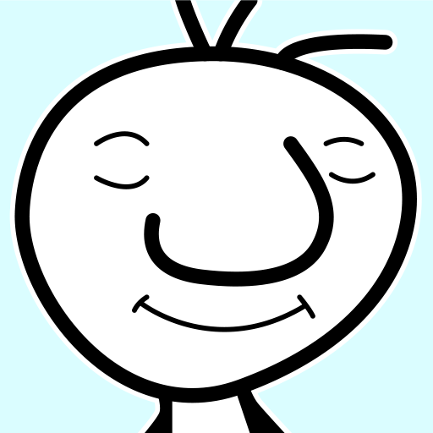
Meditation Apps
One moment meditation
Headspace
Calm meditation
Notes:
These are just a couple of meditation apps that you can download on your phone if you need a bit of guidance with it.

Slide 18
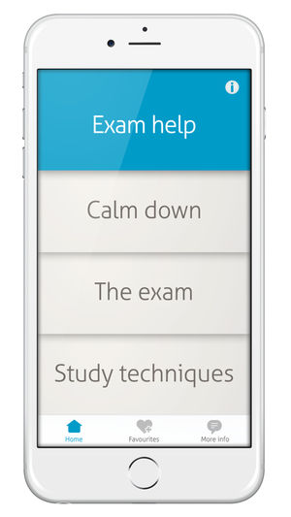
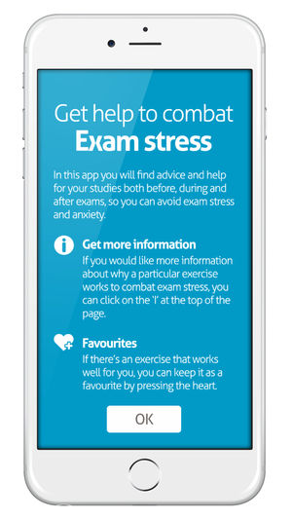
Exam stress app
Notes:
Leah
This app is for people who struggle from exam anxiety or from feeling stressed during their studies. It was developed by counsellors in a university counselling centre and derives from many years of experience in helping students to manage their exam anxiety.

Slide 19
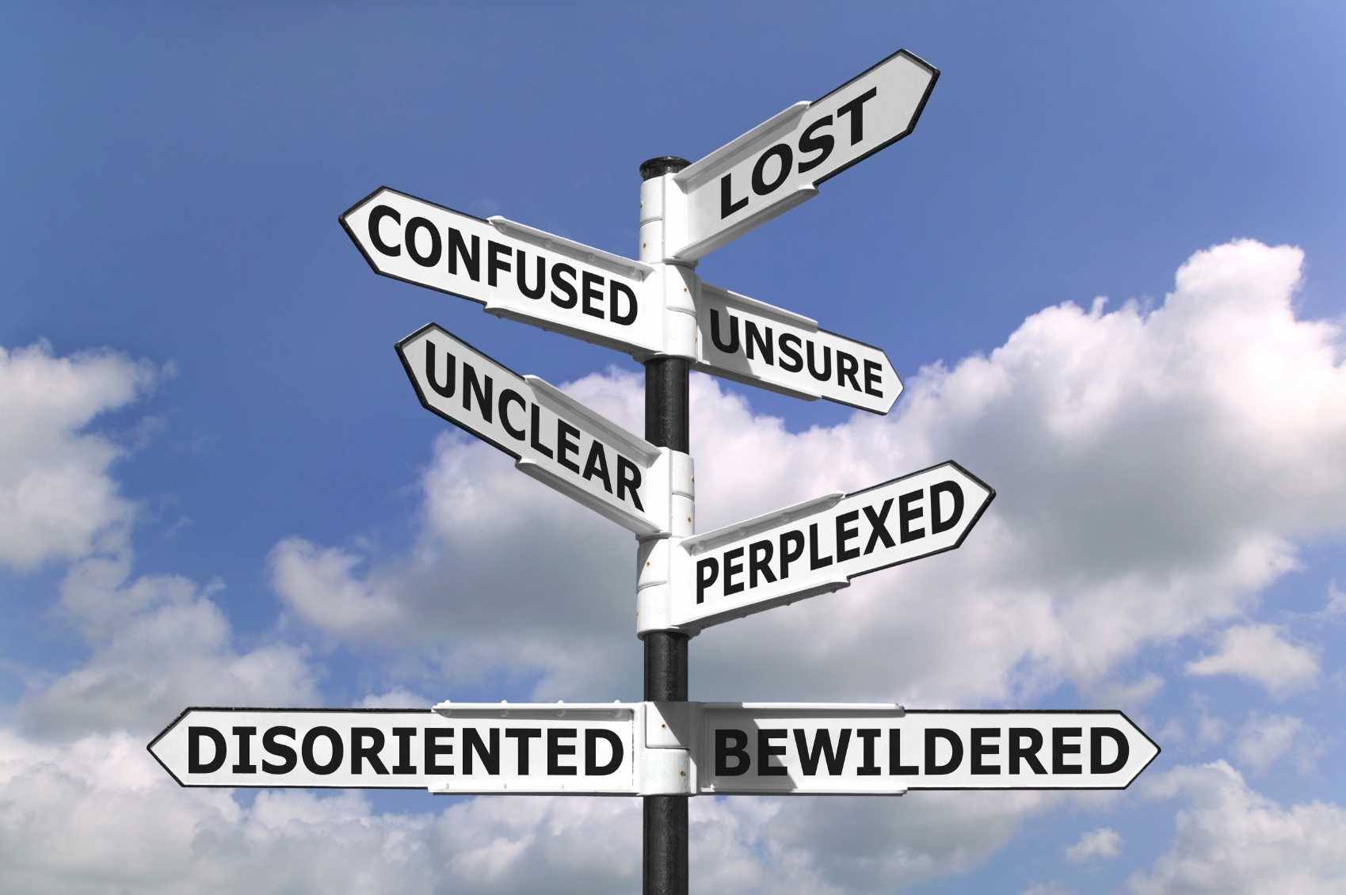
Notes:
Leah
And if you aren’t finding that the strategies you are using are working, there are lots of supports available.
UGME SA, SSBC, and Ongomiizwin Education, work together to provide a ”no-wrong-door” model of support. This means that you can reach out to any one of our offices, and we will work to get you connected to the services you need

Slide 20
Student Services at Bannatyne Campus
Notes:
Leah
We are intended to be a one-stop service hub in which students and residents can access a wide range of services to support and promote their personal and academic success.

Slide 21
Academic Learning Skills
International Services
Spiritual Care
Student Accessibility Services
Student Advocacy
Health and Wellness
Sexual Violence Resource Centre
Student Mental Health Services
Career Services
Financial Aid and Awards
Counselling Services
Confidential Intake and Triage Support
Notes:
We are the hub for many different types of services. You don’t need to “memorize” these or ask for any of them specifically, in our conversations we may suggest and connect you with some of these services.

Slide 22
Where to find us?
Call: 204-272-3190
phones are answered M-F 8:30am – 4:30pm
confidential voicemail
Send an email: bcss@umanitoba.ca
Access our website: http://umanitoba.ca/student/bannatyne/
Follow us on Instagram for up-to-date offerings: @um.student.services.bannatyne
Notes:
Adina

